Slide 1
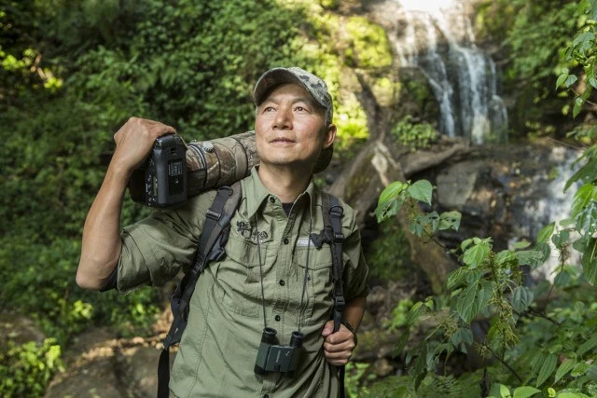
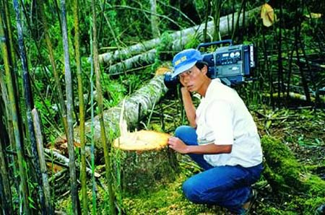
Xi Zhinong
By: Alex Gregoriou

Slide 2
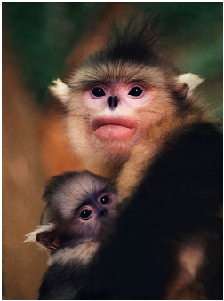
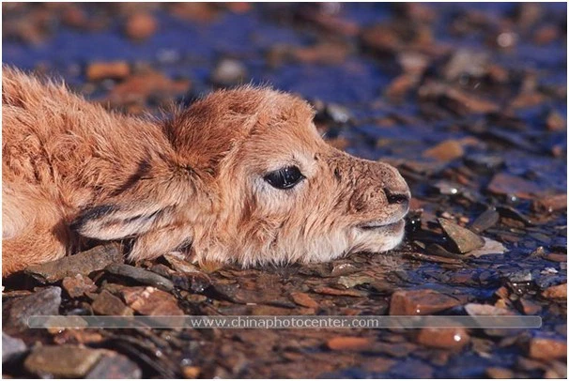
Who
Zhinong is a well-known wildlife photographer and conservationist. He spent more than 30 years in the wild to capture images of rare wildlife.
He is famous for taking the first video footage of the Yunnan snub-nosed monkey and raising public awareness about environmental conservation and endangered species in China.
He is also the founder of Wild China Film, an organization that promotes natural conservation through wildlife photography.

Slide 3
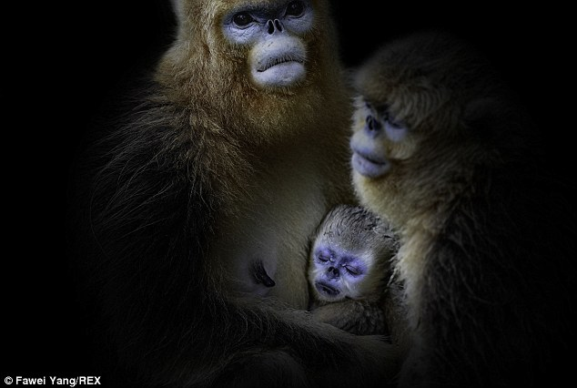
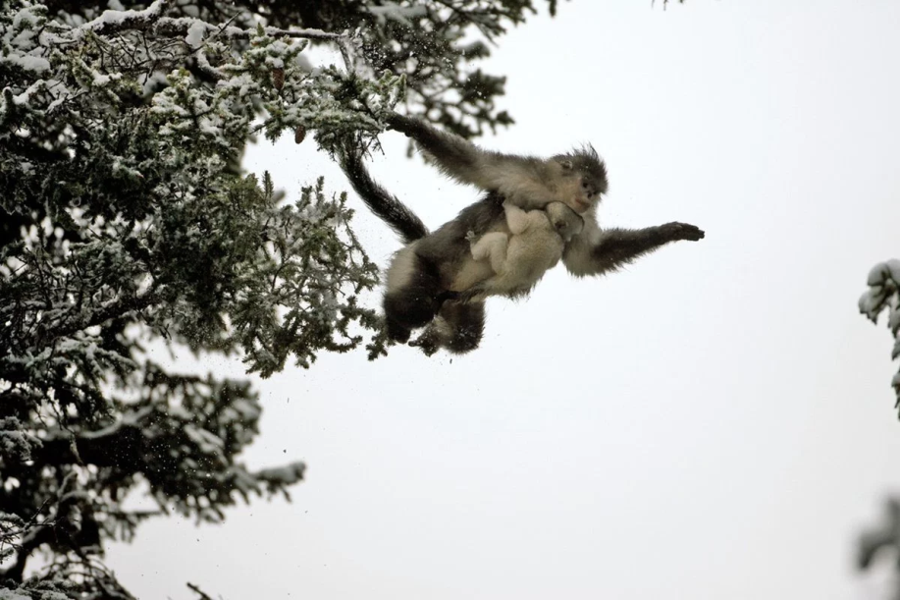
What Type of Photography
Avian and Endangered Species Nature Photography
He is most known for his photography of the Snub-nosed monkey because he was the first person to take pictures of it.

Slide 4
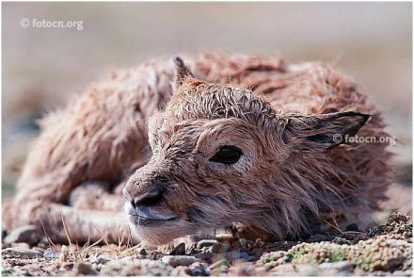
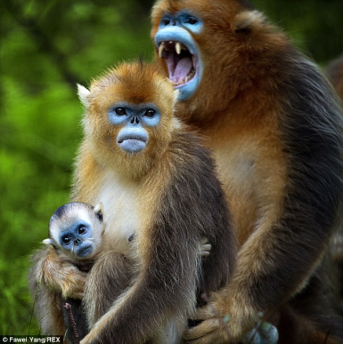
When & Where?
Xi began photographing wildlife in the late 1980s.
He was the first Chinese person to win Wildlife Photographer of the Year at the Gerald Durrell Awards for Endangered Wildlife and the TVE Award at the British WildScreen Festival.
Zhinong was always a famous photographer in China however when he volunteered to go out and shoot for the government this is when his career skyrocketed.
He takes pictures all over China.

Slide 5
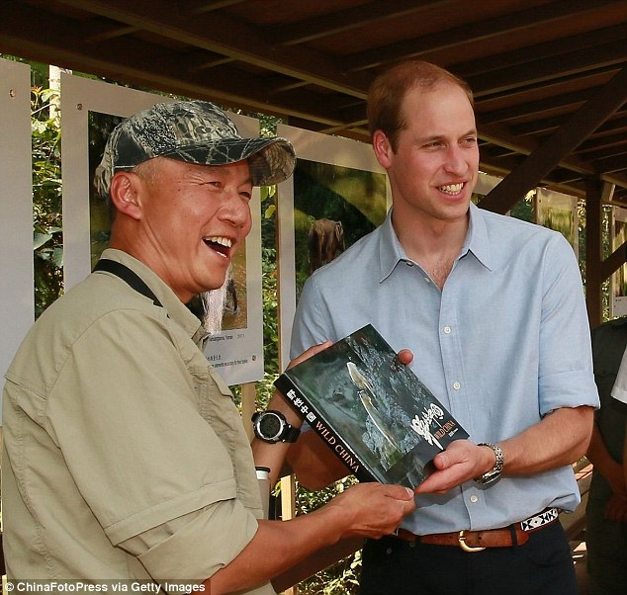
Prince William has pledged to dress up as a tree on his next visit to China so that he can go out with photographer and conservationist Xi Zhinong to photograph rare Yunnan Golden Haired monkeys.

Slide 6
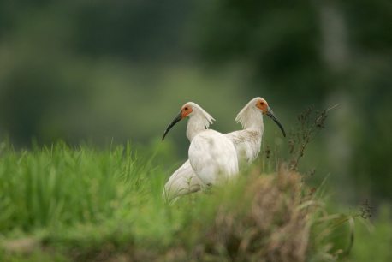
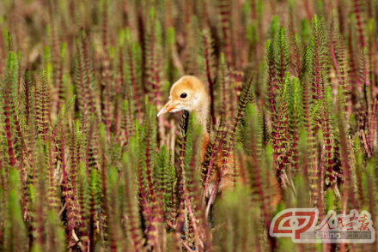
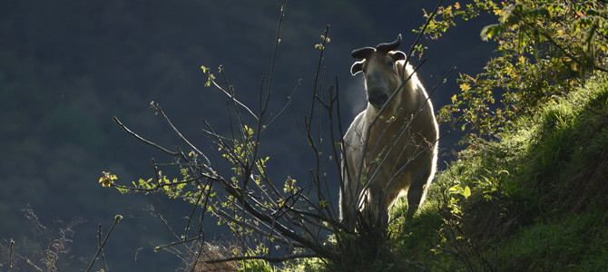
Why?
In 1993 Xi Zhinong was assigned to record wildlife for government documentaries. Xi captured the first photographs ever taken of the snub-nosed monkey.
When captured these first photographs of this endangered species he wanted each of his pictures to have a powerful meaning.
Logging interests in China's Yunnan province were destroying the limited habitat of the rare snub-nosed monkey. Xi Zhinong's photos of the rare animal helped sound the alarm.

Slide 7
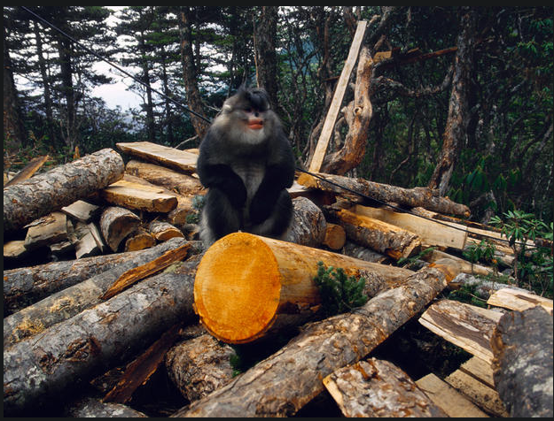

Slide 8
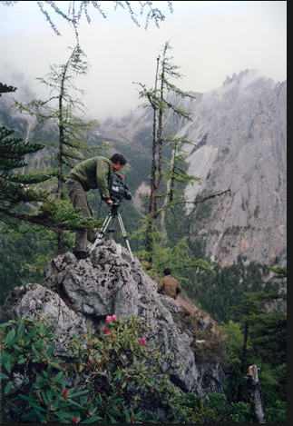
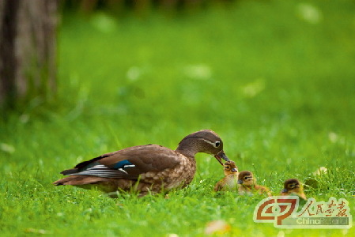
How?
Xi Zhinong would like to keep his camera settings a secret however he does state that photographing these rare monkey was extremely hard because they live at a higher elevation than any other primate on Earth and since they are endangered it makes them very hard to find.

Slide 9
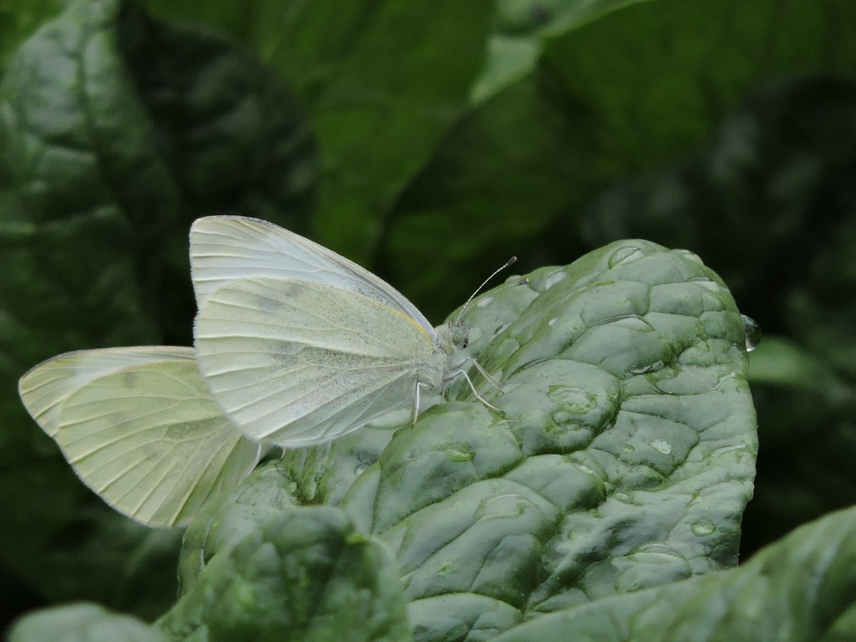
Personal Photos

Slide 10
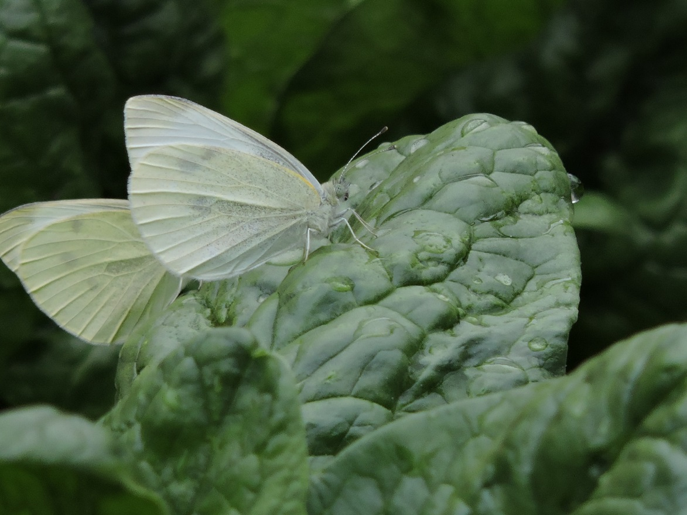

Slide 11
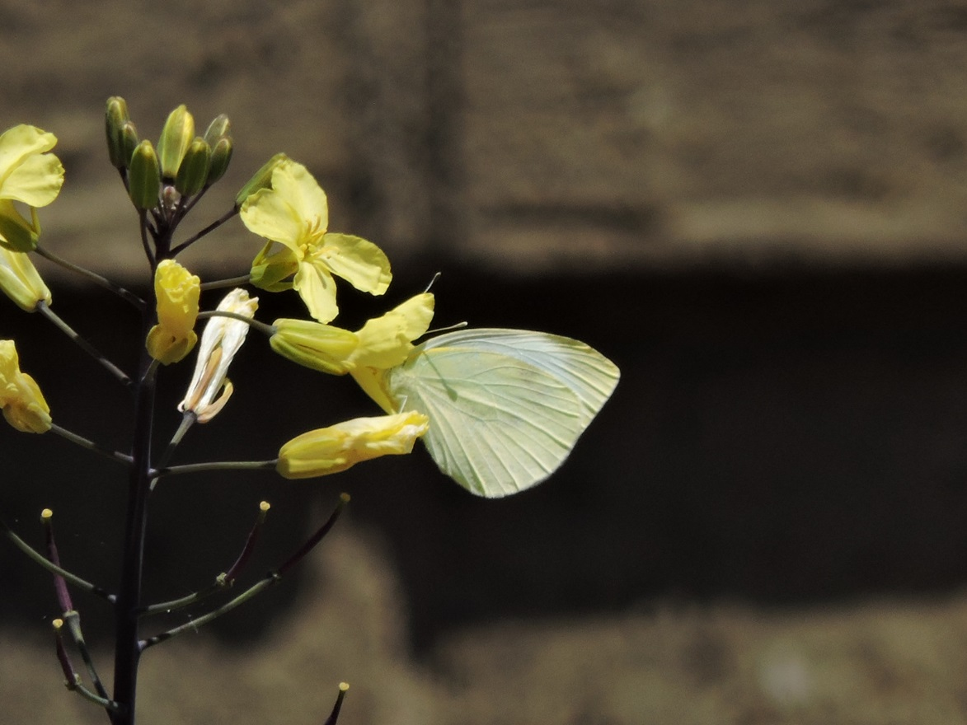

Slide 12
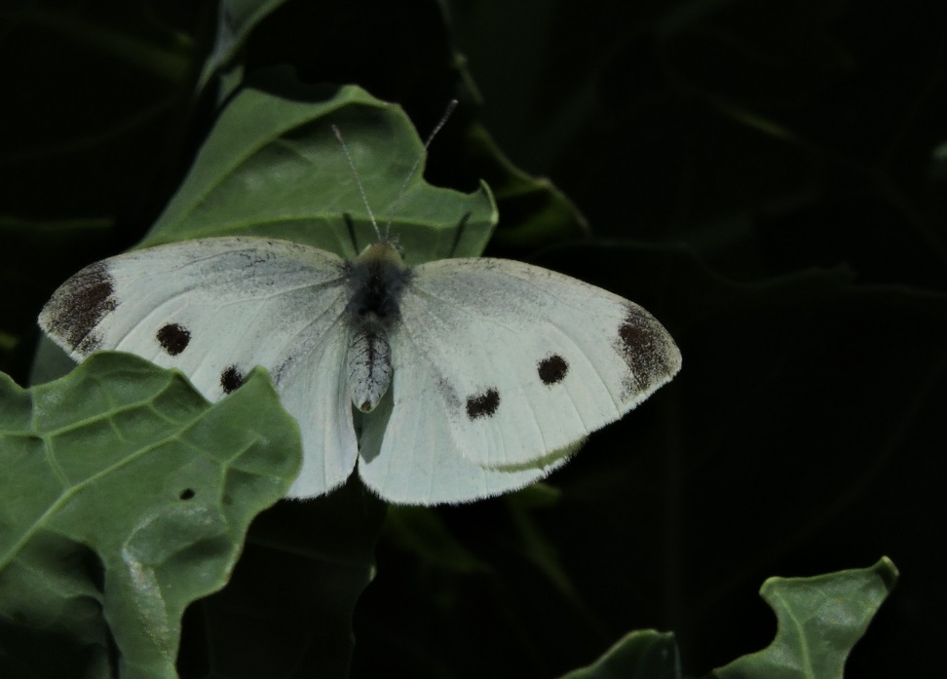
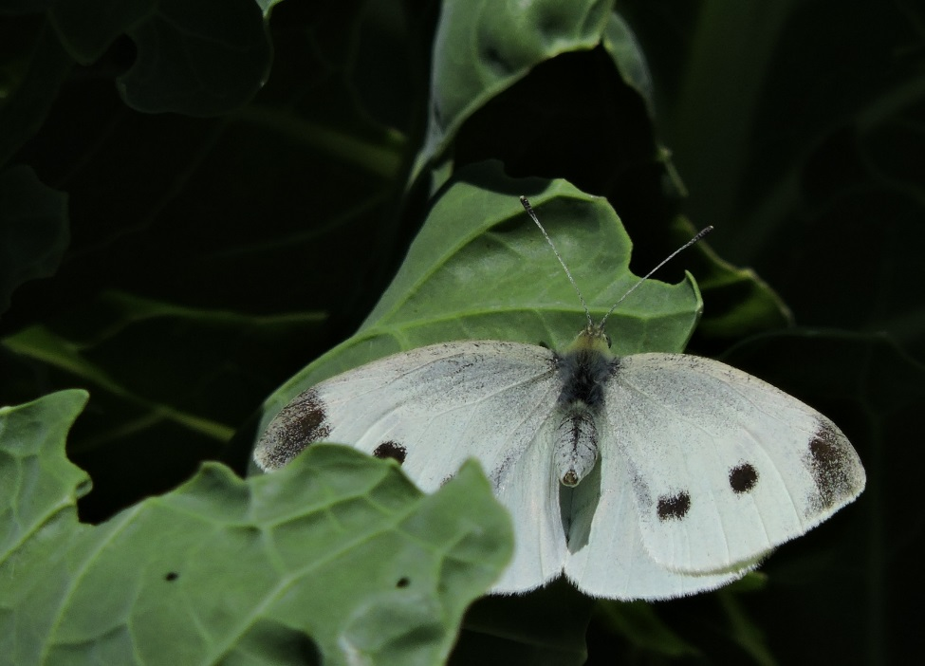
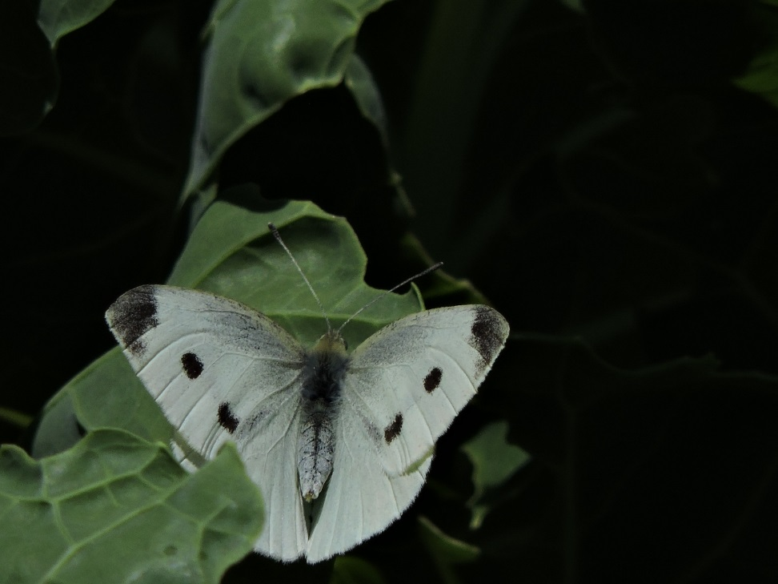
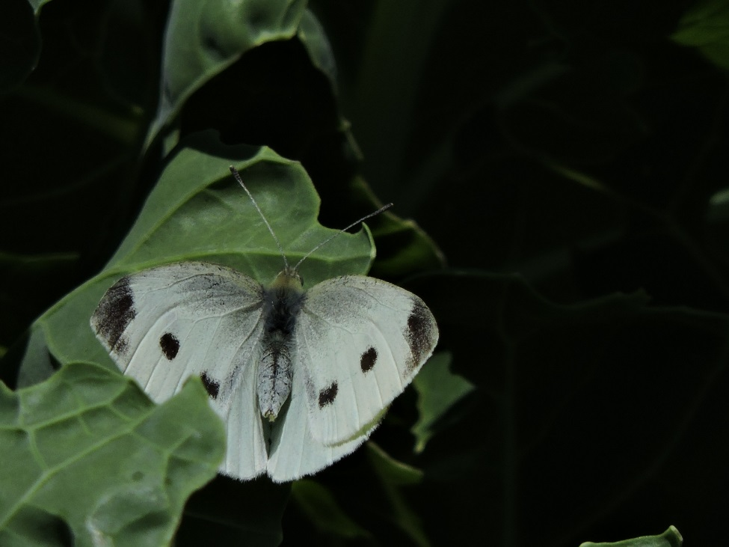

Slide 13
Websites Used
http://www.dailymail.co.uk/news/peoplesdaily/article-2991718/Photographer-reveals-Prince-promised-dress-TREE-time-s-China-expedition-country-s-famous-golden-monkeys.html
http://www.cbsnews.com/pictures/chinas-rare-snub-nosed-monkeys/3/
http://www.cctv-america.com/2015/05/14/photographer-xi-zhinong-uses-camera-to-protect-wildlife
http://www.chinapictorial.com.cn/en/features/txt/2013-09/04/content_565593.htm

