Slide 1
Toby Keller’s light painting
By: Kelly Ratcliff

Slide 2
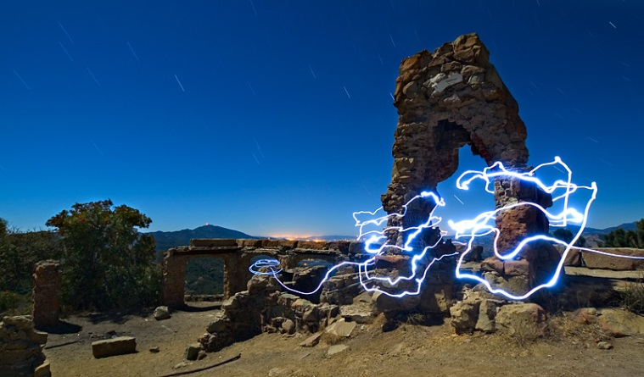
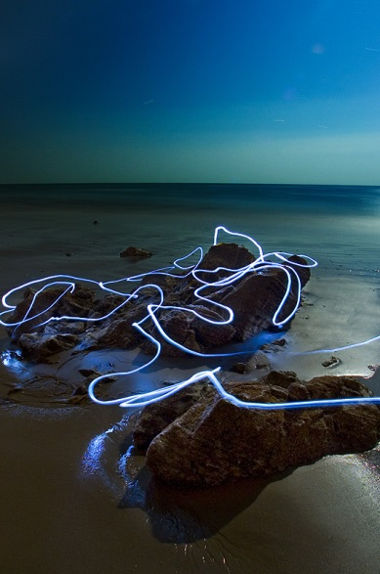
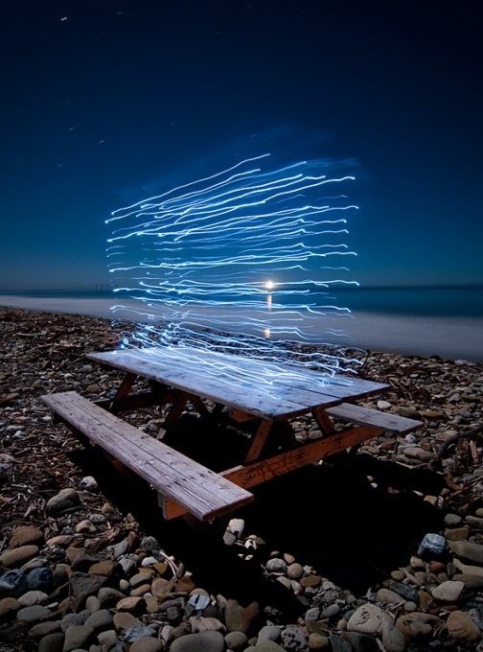
About his work
Taken on local California beaches
Worked with light painting techniques using LEDs, EL wire, and black lights to create light trails on the image
These images encompass his light paintings series of long exposure photographs.
Were made by the light of the full moon and feature traces of light created by various small powered light sources moving across the image plane.
Used a long shutter speed

Slide 3
My thoughts on his work
Toby Keller is an inspiring light painter that uses blue lights to enhance a view to make it more spectacular than it already is.
I think it’s astonishing that he takes pictures that have a much deeper meaning than other photographers and he was self-taught in the process.
I love how he got it so that the people that were in the photograph moving the lights weren’t seen in the picture.
His work shows me that you really have to think about every little detail when taking a photograph.

