Slide 1
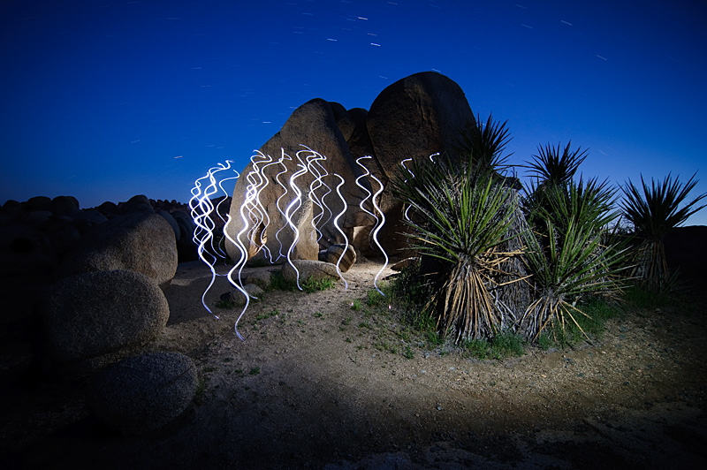
Toby Keller
By: Robin Cole

Slide 2
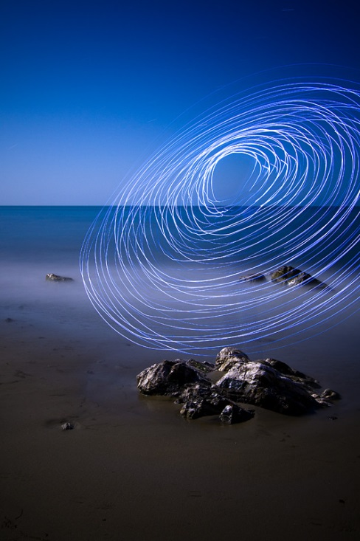
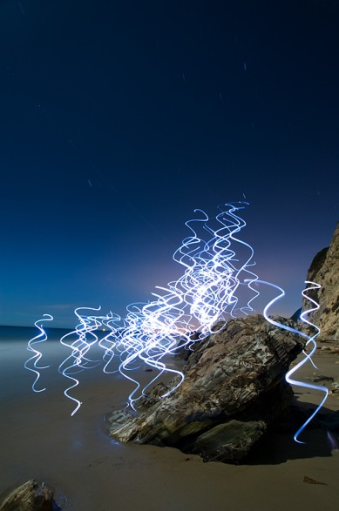
Images of the work

Slide 3
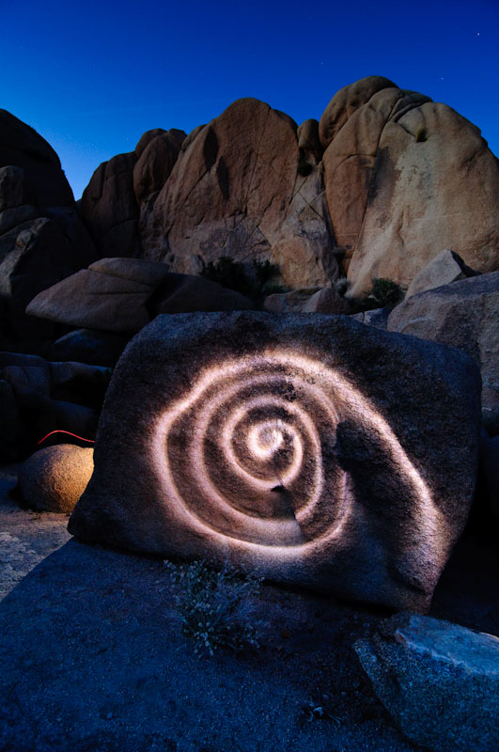
Details about the photography
Toby Keller did blue light painting in the dark on the beach and made some ocean like beings on the shore and on the rocks.

Slide 4
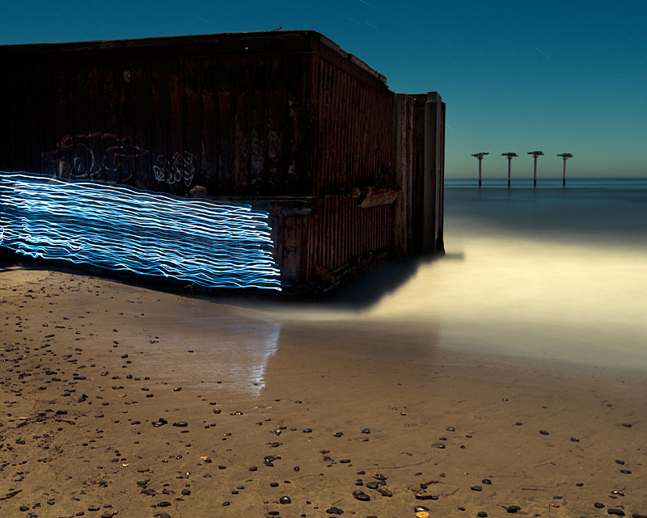
Details about the process
ISO~ 400
SHUTTER SPEED~ SLOW
I think he ran around or spun around really fast to get the effects he did or he used time lapse and set it at ten seconds to get the effect he had in each photo.

Slide 5
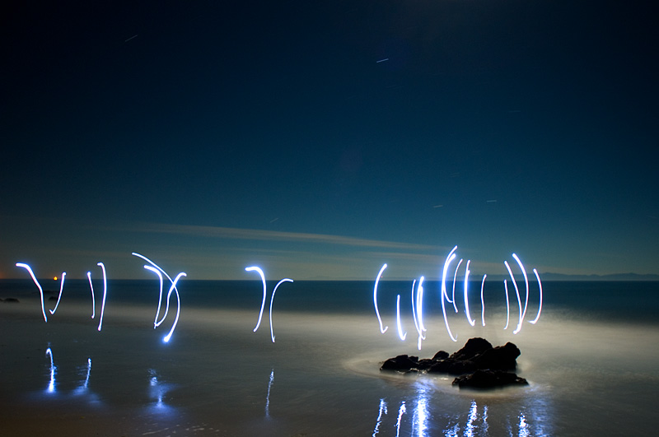
My thoughts on the work
I think that Mr. Keller truly captured the view of the ocean or perhaps the coast where all the seaweed and shells are that people are fond of keeping. He brought the ocean life on shore and used blue which tied in very well with the color of the ocean. He used the spacing in his photos well and didn’t leave any unwanted negative space. He did an amazing job and portrayed the beauty of the ocean extremely well.

