Slide 1
Light PAINTING
By: Skye Tomkins

Slide 2
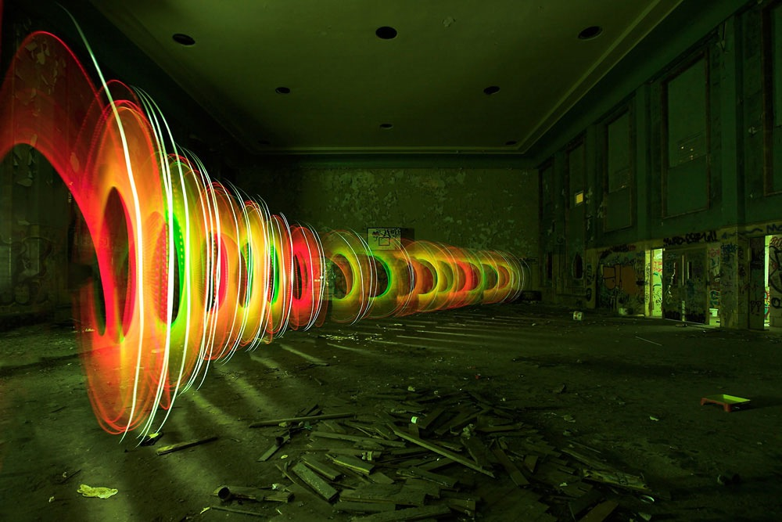
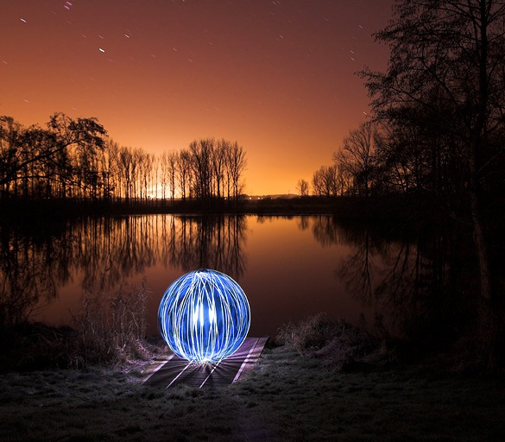
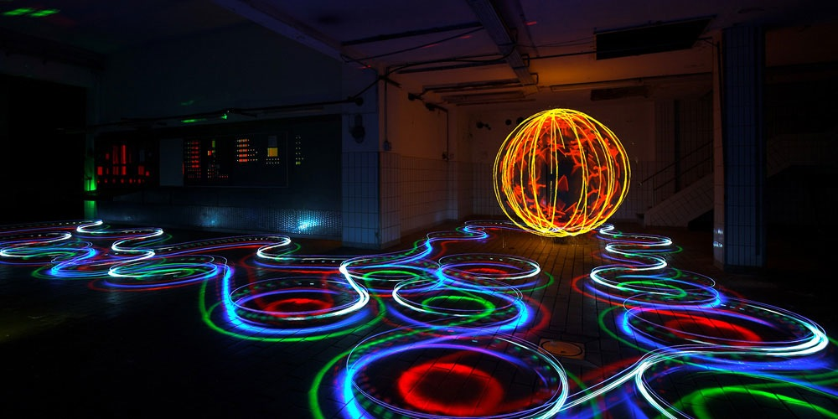
jan leonardo wöllert’s photography

Slide 3
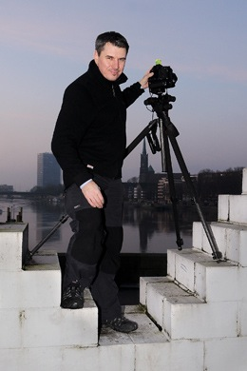
Details about the photogrApher
Jan Leonardo is a self-taught photographer.
Grew up in Worpswede, Germany.
He started with landscape light photography in 2005 & LAPP in 2007.
He has numerous awards & published works.
His favorite camera is the Sony A7R, together with Sony FE 35 mm F1.4ZA or Carl Zeiss Distagon T 2.8/15 with a Nikon to Sony adapter Lenses

Slide 4
Details about the photography
He uses Sony A7R, together with Sony FE 35 mm F1.4ZA or Carl Zeiss Distagon T 2.8/15 with a Nikon to Sony adapter Lens.
He uses a long pole that has fire works on the end. He spins the pole around in choreographed movements to capture his images.
He uses time exposures to fix them on film. He likes exposures because he uses time as his stage to make art with light.
He uses pyrotechnics or LED lamps for his medium.
He does not digitally refinish his photos. He wants them to be authentic.

Slide 5
Details about the process
He travels through Europe looking for places he can set off his fireworks.
He works exclusively at night.
He has to pay attention to reflective surfaces when choosing his location.
He uses bright torches from Led Lenser (Led Lenser X21R.2), with a special Advanced Focus System.
The Sony A7R he uses has the best Live-View for being able to focus at night. This camera, plus the Led Lenser torch and a View Finder allows for him to perfect his focusing.

Slide 6
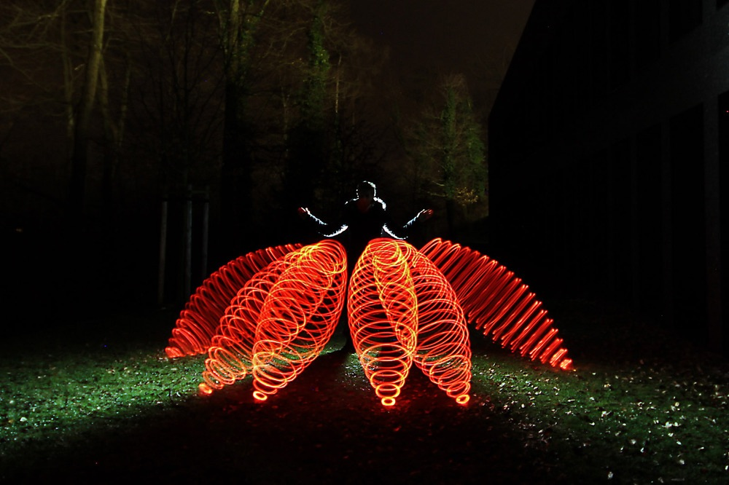
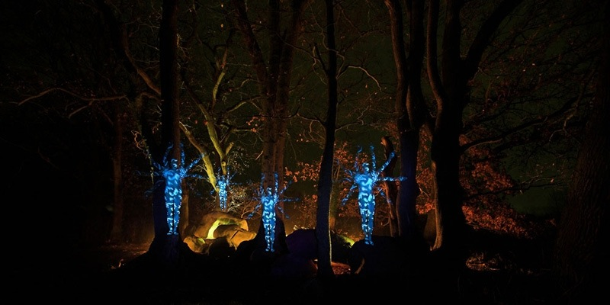
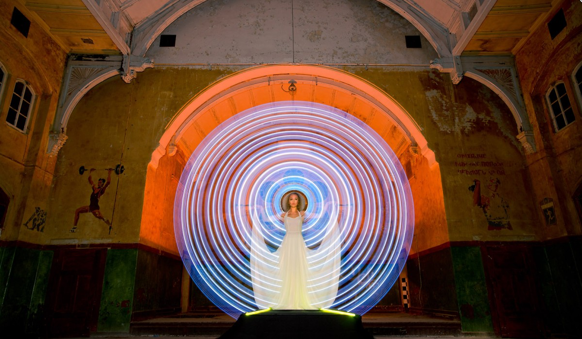
Thoughts on the work of jan leonardo wöllert
His work is very creative. It is bright and choreographed in a unique way. I like the use of fireworks because it symbolizes power. It’s amazing that he has no formal training when it comes to photography, yet he has made a name for himself by being one of the most well renowned light photographers. He brings light to dark places, which helps to bring new meaning to the images he creates.

Slide 7
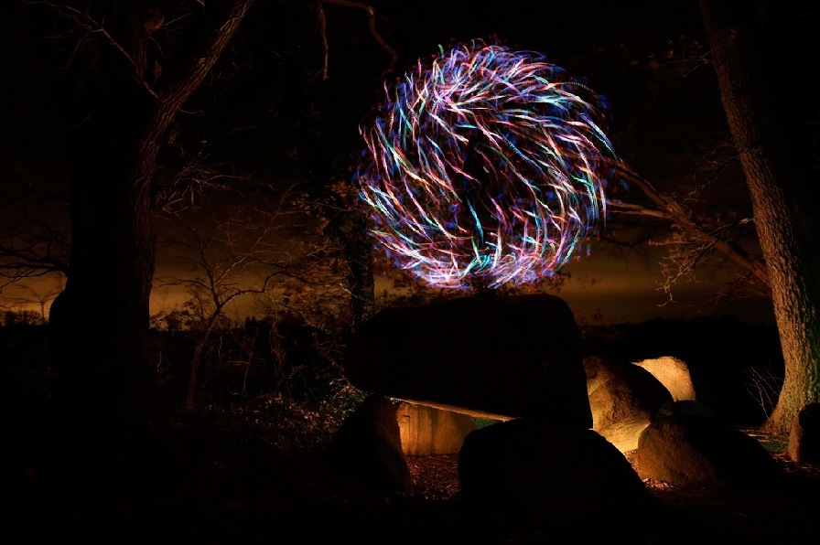
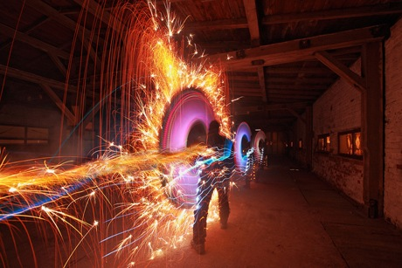
Additional light painting

