Slide 1
Photographer: Hannu Huntamo
Essence Almond

Slide 2
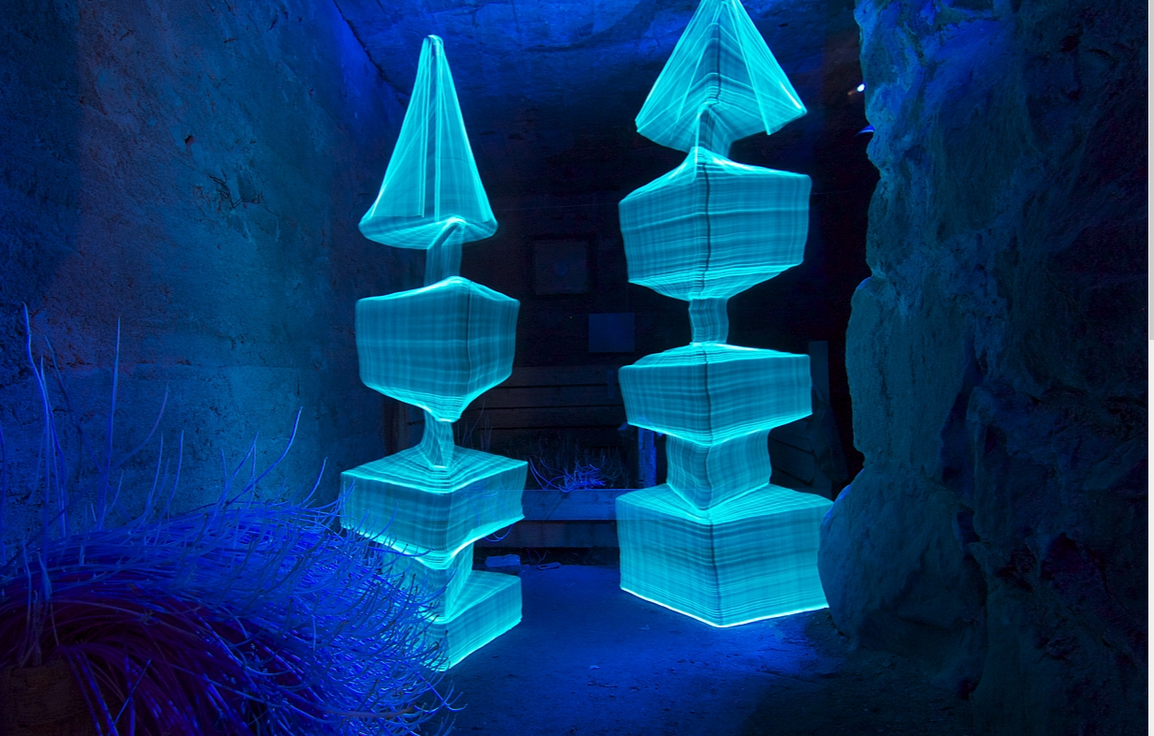
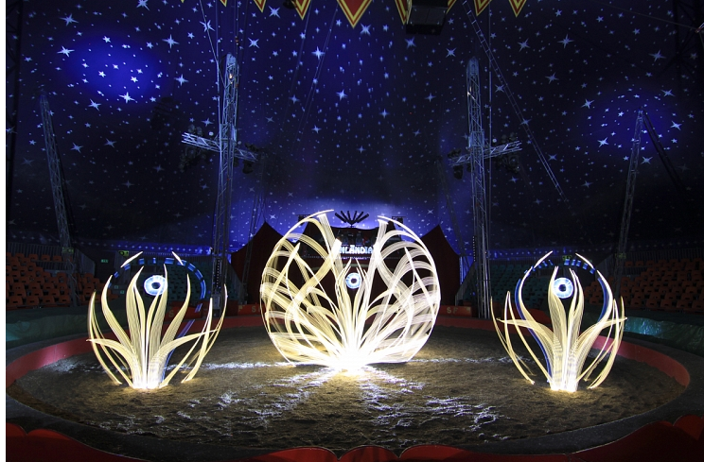
WORK

Slide 3
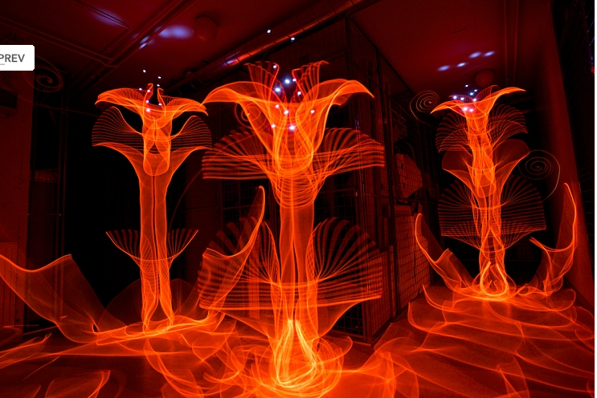
Hannu Huntamo
Hannu been light painting since 2008 and in the 1990s he had shot hid first image. Hannu is also an musician, Janne Parviainen inspired him to light paint and his work is more focused on organic forms.
The reason he light paints is because its feels like magic to him and he picture himself as a child in a wonderland. He shoots in the winter from 7 in the afternoon to 11 at night and in the summer nights from 1 in the morning to 4 in the morning.
“The camera shutters are open you are able to draw in the air by moving different kinds of light sources in front of the camera. Light painting requires a dark environment and it’s usually made at night.

Slide 4
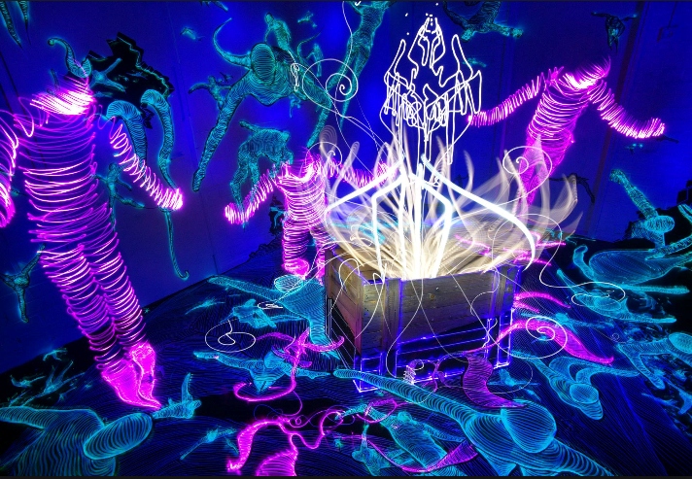
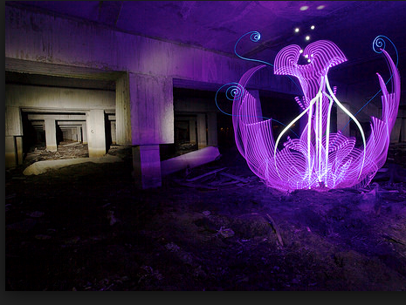
THE PROCESS OF LIGHT PAINTING
He uses a Canon 5DmkIII and 17-40mm lens camera and he shoots in narrow places and all his light tools are self made.
He self made his light tools instead of using regular lights tools.

Slide 5
MY THOUGHTS
I really like his light painting it caught my attention by one glance and I thought it was very interesting.
His paintings inspired me a lot because now I'm more into doing different types of light painting in different areas and making my own lighting tools.
His photos are very strong and each picture tells a story and you can have a million ideas on what you think the story is and when I was looking at it 3 stories popped in my head as I was looking at it.

