Slide 1
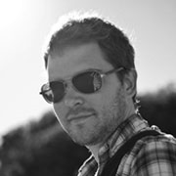
Toby Keller Santa Barbara, California Light Painting
By: MICAH GALLOWAY

Slide 2
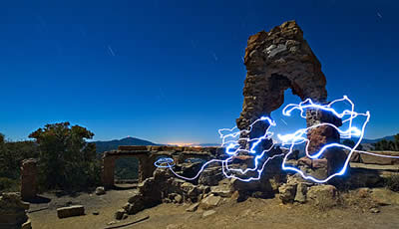
All of toby Keller”s photos are shot in Santa Barbara, California

Slide 3
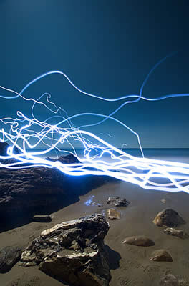
He has been working with light painting techniques
LEDs
EL wire
black lights to create light trails on the image. These images encompass his light paintings series of long exposure photographs.

Slide 4
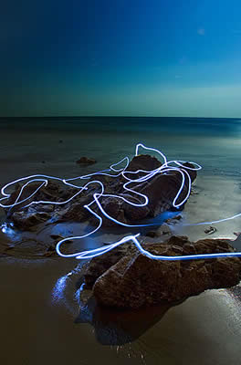
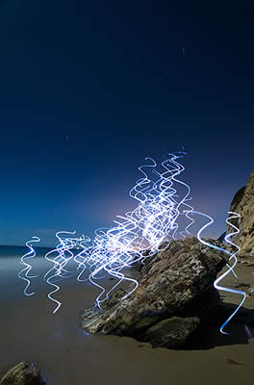

Slide 5
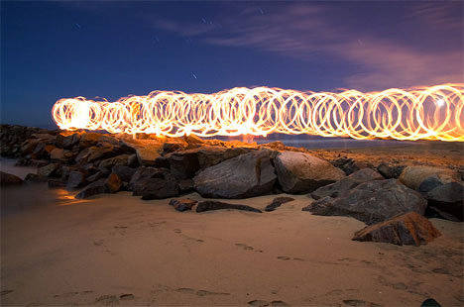
Why?
Keller takes what would already be beautiful nature photography and makes it seem to crackle with energy as ribbons of glowing light swirl around groups of rocks by the sea.

Slide 6
My theory
Toby Keller’s light paintings use a series of long exposure photographs.
It appears that they were made by traces of light created by various small powered light sources moving across the image plane.
My opinion
I feel that you could live in a city for so long and still see beauty and in Toby Keller’s case enhance by doing the light painting to an already beautiful photo.

