Slide 1
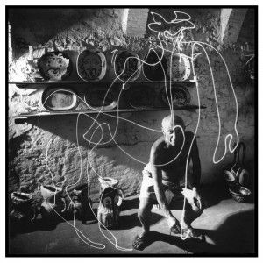
Pablo Picasso Light Painting.
By Peter Cortapasso

Slide 2
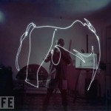
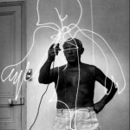
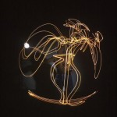
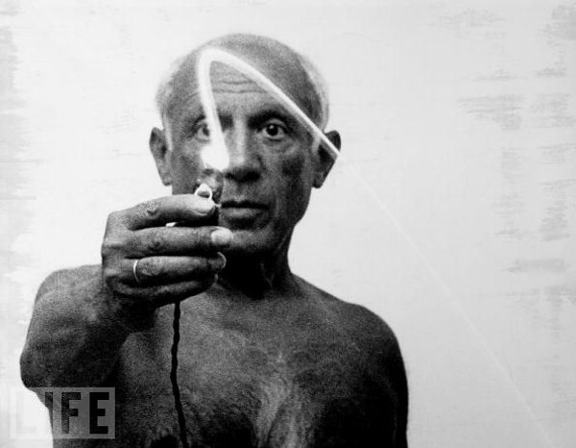
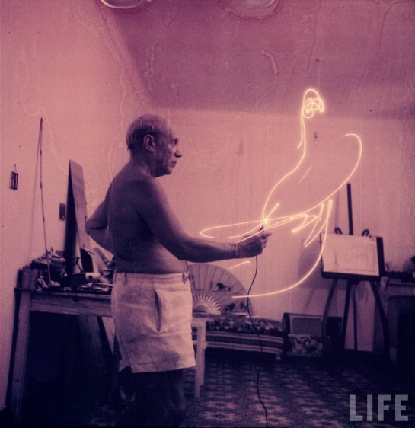
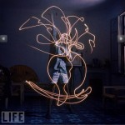
Examples of Pablo’s work.

Slide 3
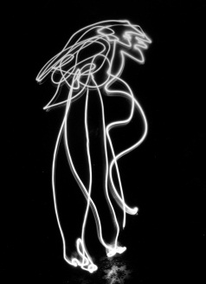
History behind Pablo Picasso’s work.
He didn’t begin to light paint until his later years.
Pablo made sure he was the focal point of his work.
These pictures are more then 60 years old.
Picasso drew everything from Greek mythological creatures to his signature in the air.
An excerpt from a 1968 special issue of LIFE, devoted entirely to Picasso, describes a typical scene at his home: “Putting on a mask is sometimes enough to set Picasso off into a kind of witch-doctor frenzy. He roars and writhes behind his gorilla mask, dances away to the mirror, returns in a rubber devil’s mask to swoop down on his daughter Paloma. Picasso was one of the first European artists to recognize the magic and beauty of African masks, and his own masks show the enduring power of that early influence.” – From TIME magazine.
All of this started when Mili and Picasso met in Picasso’s home in the south of France.

Slide 4
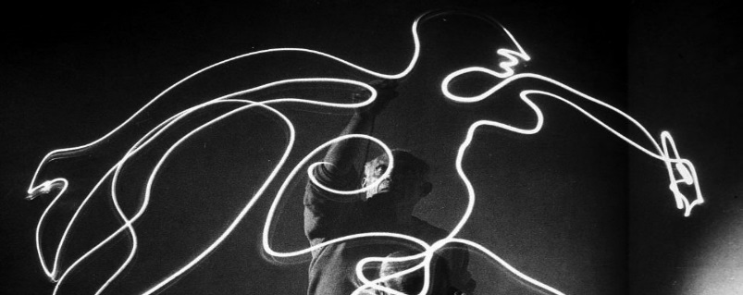
Pablo’s process.
Armed with only a camera and a flashlight.
Had to make all his photo split second because the light wouldn’t last
Had to use 1968 technology.
His art reflected the things he knew well, images, stories etc.
Pablo used a low ISO and a slow shutter speed to capture these works of art.

Slide 5
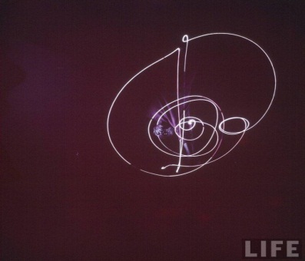
My thoughts:
I believe that Picasso being a pioneer of light painting set the bar high considering he created such intricate images expressing his feelings and prior experiences that I can really put my self in his shoes seeing the world as he did. I also believe despite whether you enjoy his art of not recognizing his genius is imperative because the technology he used was very basic yet he was still able to create full, clear and beautiful pieces of art that people in the 21st century would have trouble creating. In conclusion I believe Picasso was a true genius and a pioneer in his craft despite his odd mannerisms finally his uses of shutter speed, manipulation of light and composition/focal points prove Pablo Picasso was truley ahead of his time.

Slide 6
References:
http://www.thecoolist.com
http://time.com
http://www.bing.com

