Slide 1
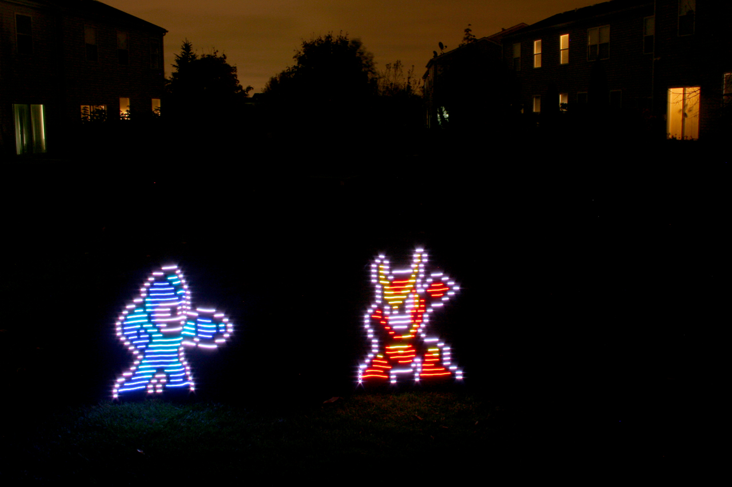
Michael Ross
By: Antyreo Green-Jones

Slide 2
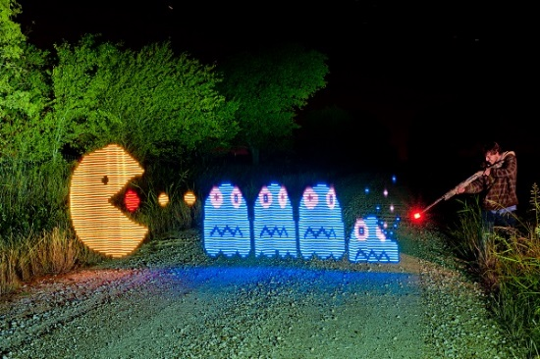
Details about the photography
Michael’s photography is made by a light wand that is a RGB LED strip that will take software commands.
He created this with his experience of IT
Most of these paintings are made at night

Slide 3
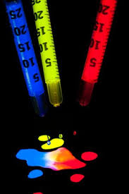
Details about the process
Michael uses the light wand in addition to slow shutter speeds in order to create these paintings
With the light wand, Michael uses a program to “visualize” the pattern he wants to make with the light wand and when he’s done, he turns on the light wand and it creates the pattern he visualized.

Slide 4
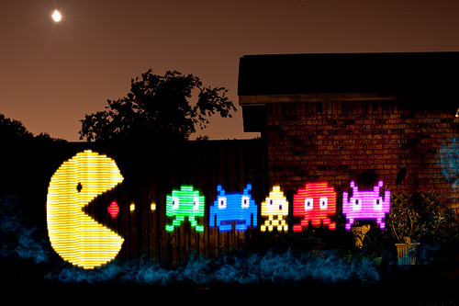
My thoughts on the process
This photography is very interesting because of the process used in order to create the photo.
I also find interest in this photography because he light paints some video game scenery.

