Slide 1
Michael bosanko

Slide 2
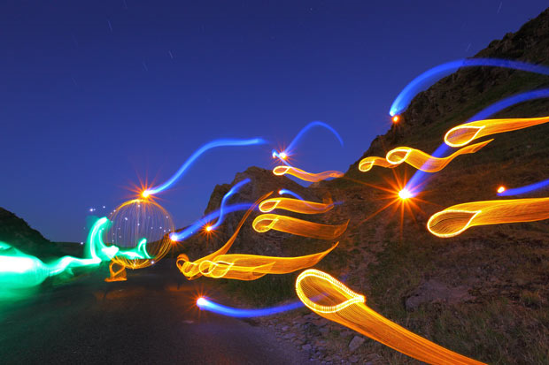
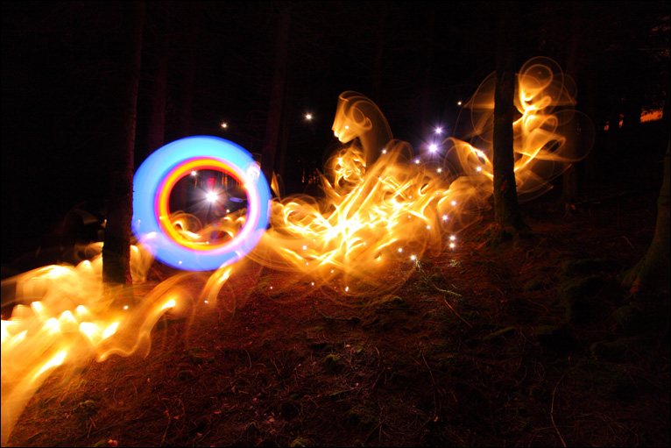
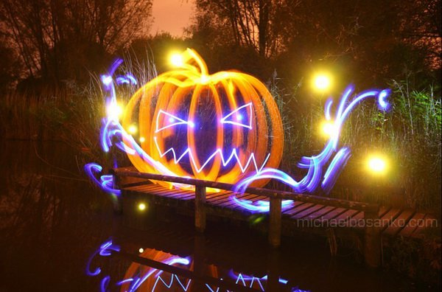
His work

Slide 3
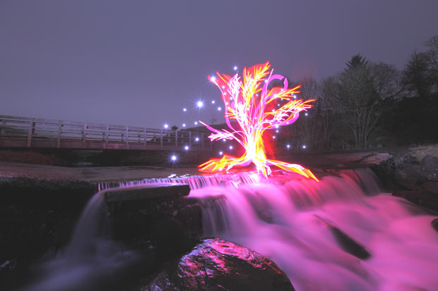
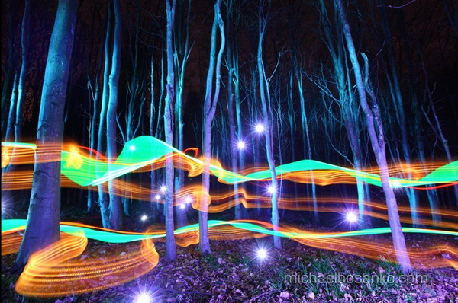
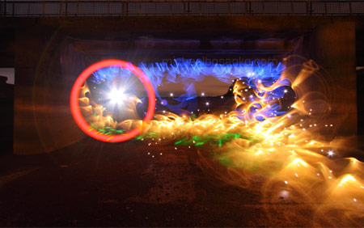
Light Graffiti
Michael Bosanko is a light painting graffiti artist who makes different graffiti art- like shapes in light.
He started light graffiti when he was taking a picture and the camera shook while the moon was in the picture, which created a streak.
He then took the camera off the tripod and tried to make different things with the moon light.

Slide 4
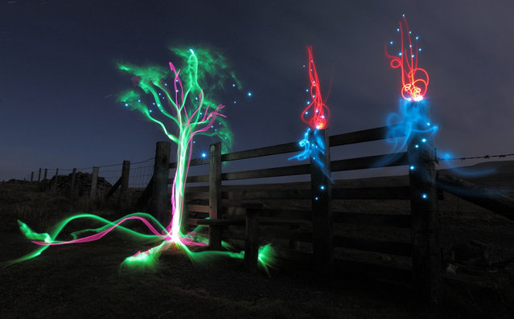
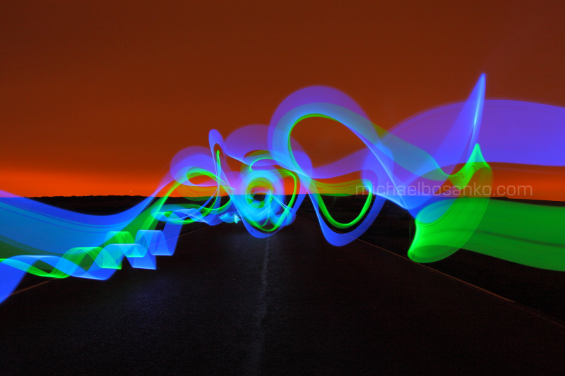
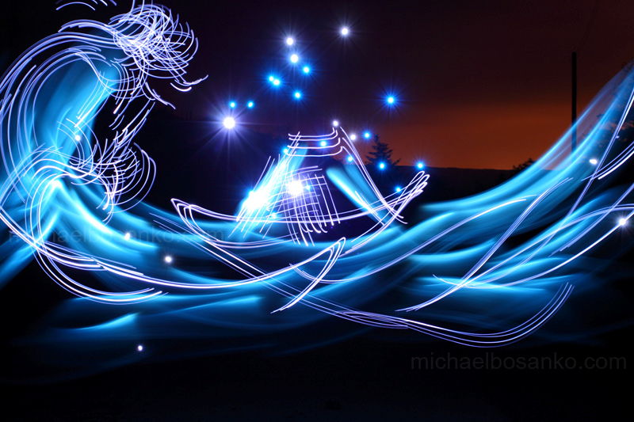
His process
He uses many different tools in the process of making the graffiti for the picture and the setting he uses to take the picture vary.
His camera settings vary depending on what the environment he is in or what he aims for his photo to turn out to be.
His exposures range from a few seconds to a few hours.
The lights he uses are torches of many different styles, standard light bulbs, LED, fire and anything else he can find or make.
His cameras are an digital pro Canon gear and film

Slide 5
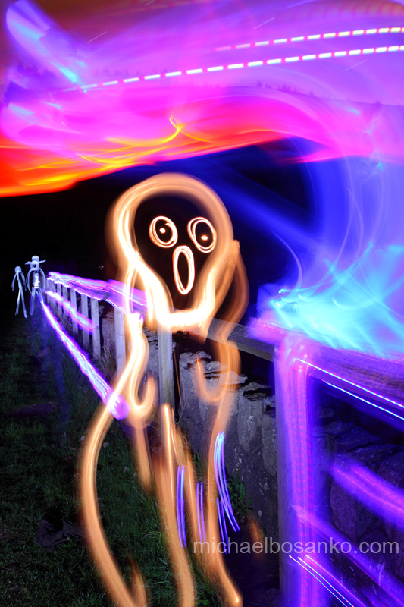
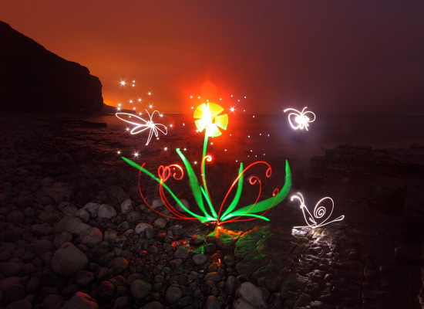
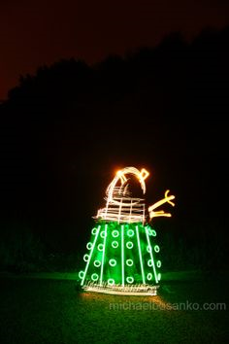
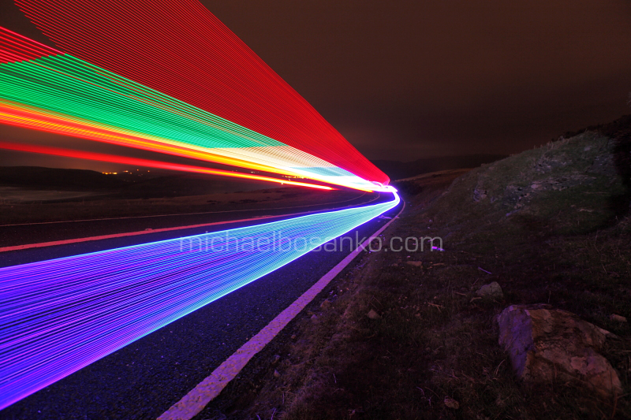
My thoughts
His work is outstanding and its fascinating to look at.
It makes you wonder how he did it and keeps you coming back to look at more.
His work is inspirational and makes you want to try light graffiti for yourself and see how it turns out.
Though the process can be long and you would need many different tools with a very creative mind I believe anyone could do it.

