Slide 1
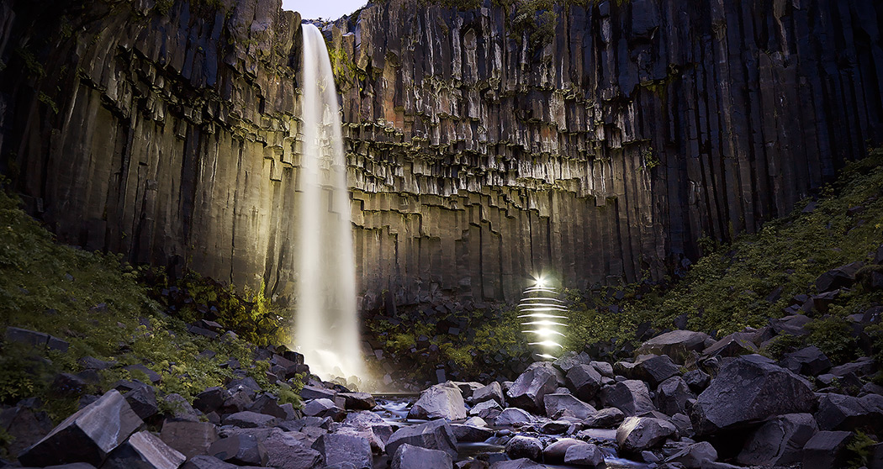
Lightmark
By: Brianna Wade

Slide 2
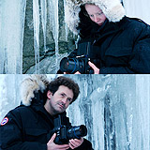
About the photographers
Body of work by German artists Cencil Goepel and Jens Warnecke
Travel all over the globe to capture different landscapes
They take their photos in the dark to show its magic and beauty
They travel around the world turning light into day
Have been published in many major magazines and books

Slide 3
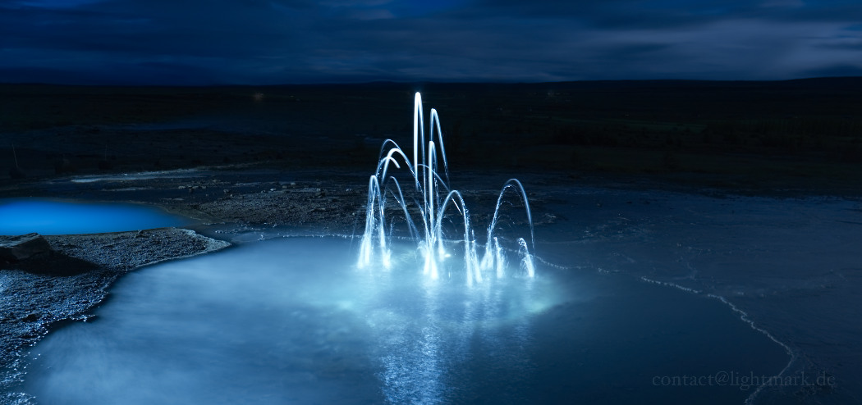
No. 107

Slide 4
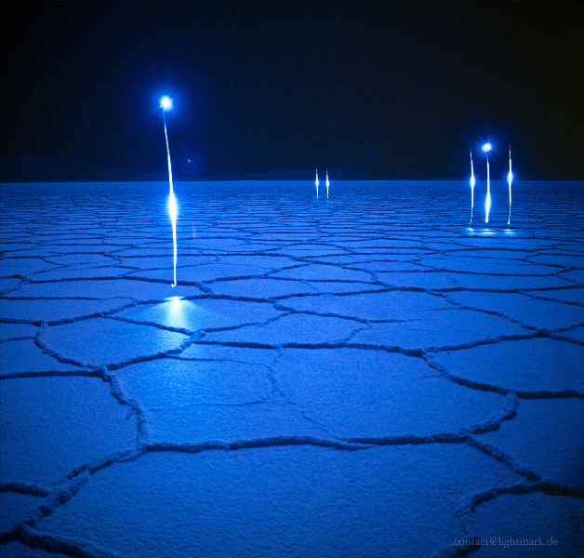
No. 53

Slide 5
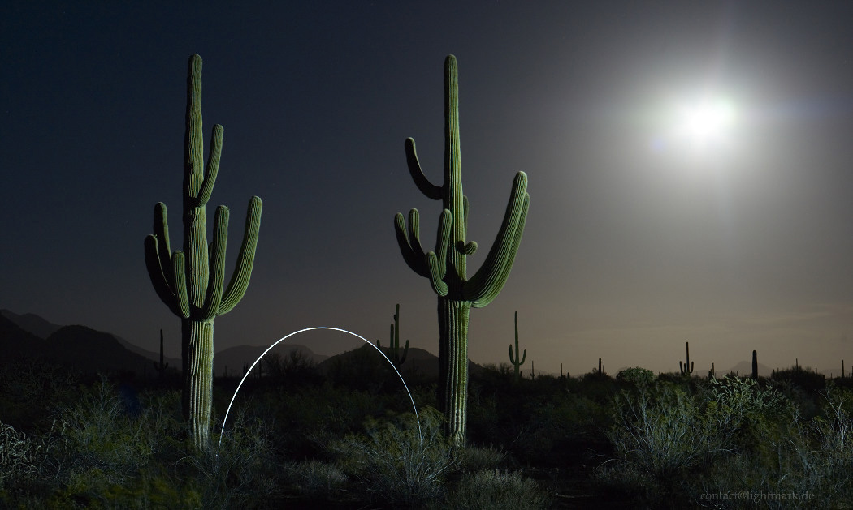
No. 111

Slide 6
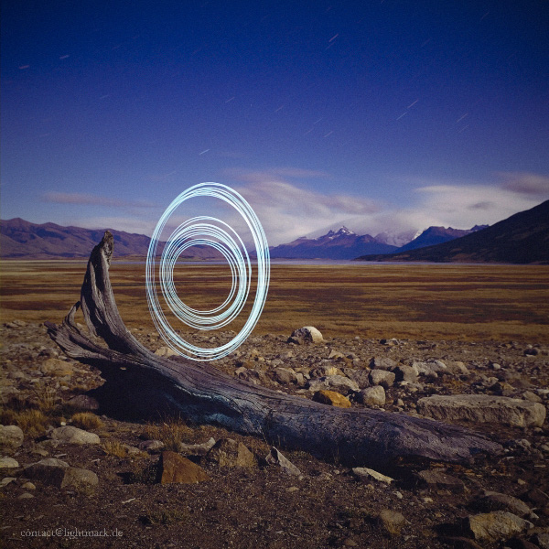
No. 54

Slide 7
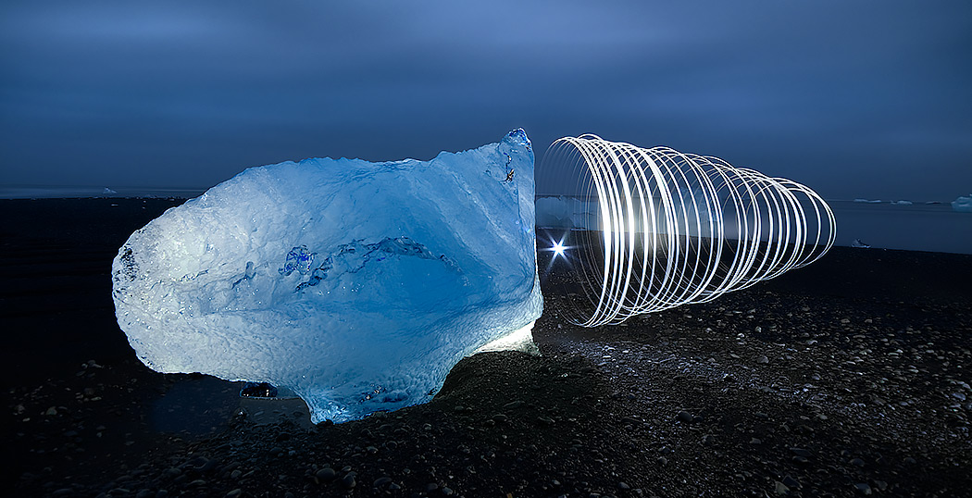
No. 124

Slide 8
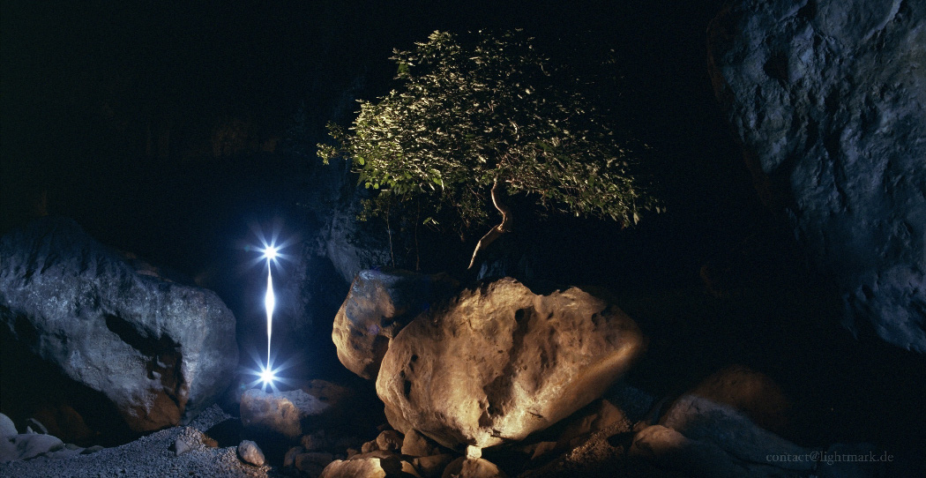
No. 42

Slide 9
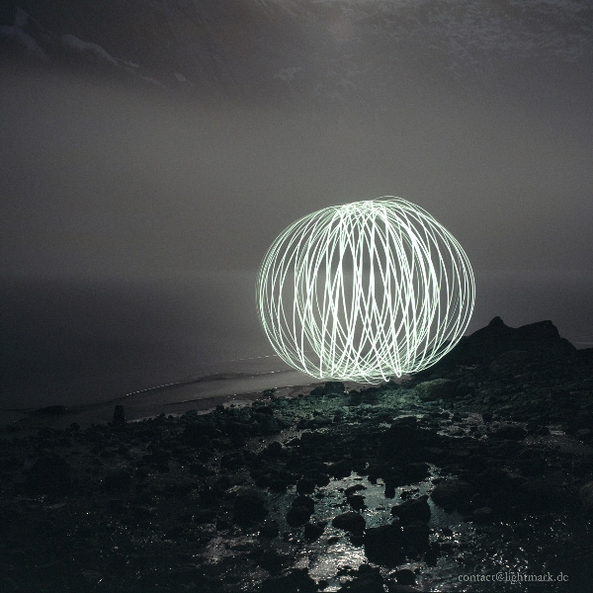
How they do it
Move light sources at night
Long exposure, up to an hour at a time
Very low level of ambient light, usually moon to illuminate the scene
Modified torches, carefully placed fire
Slow shutter speed
AF 645 camera with a p45+ digital back

Slide 10
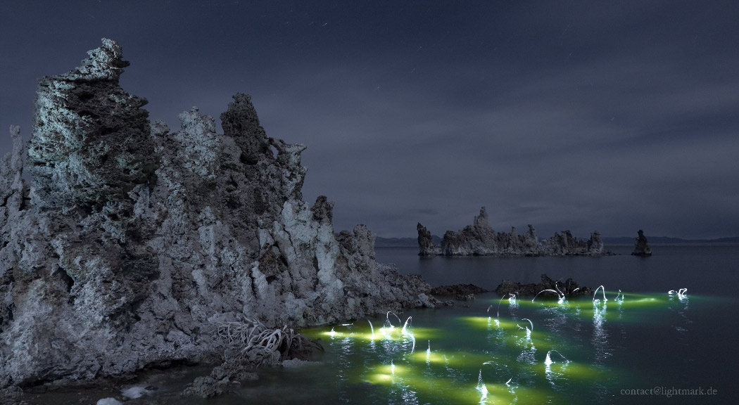
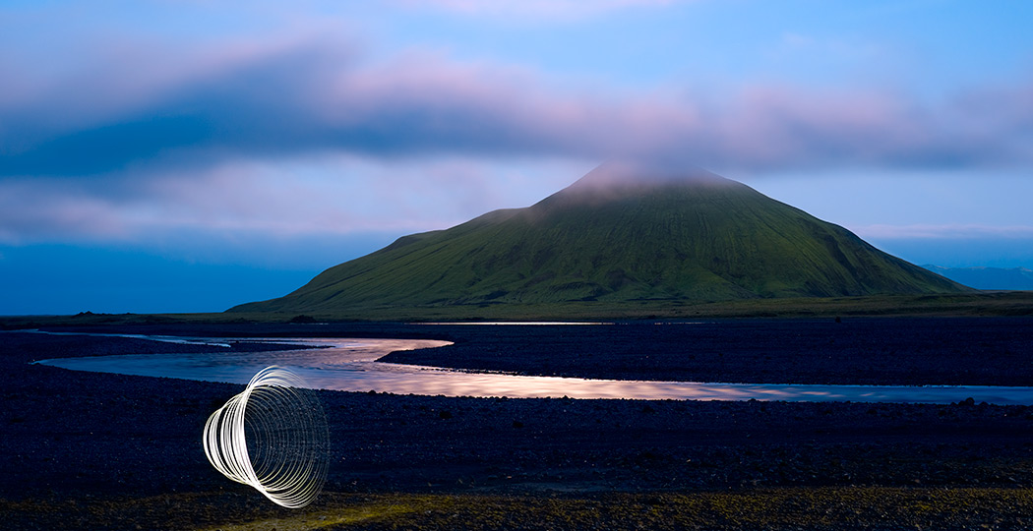
My thoughts
Light adds beauty
Supernatural/magical
Oddly placed on purpose
Adds liveliness to surroundings

Slide 11
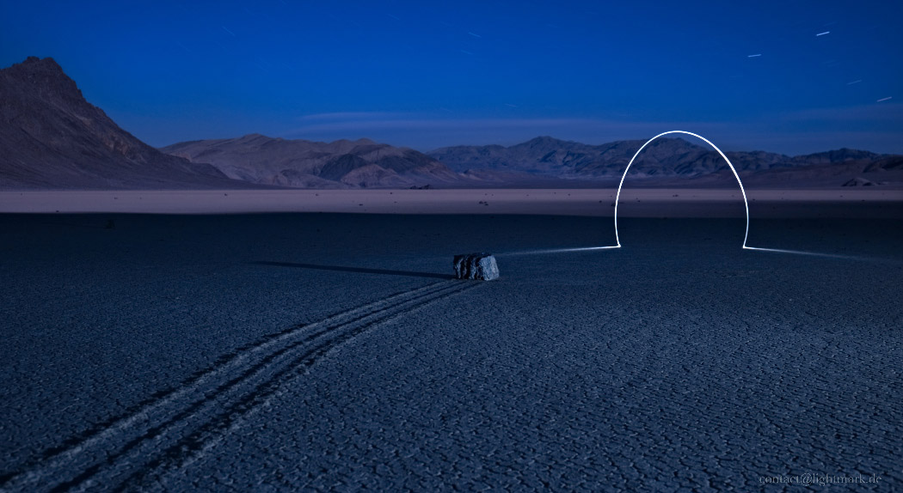
Citations
http://lightmark.de/lightmark_105.htm
http://lightpaintingphotography.com/light-painting-artist/featured-artist-2/lightmark/

