Slide 1
Lighting Painting Research
By: Caroline Keep

Slide 2
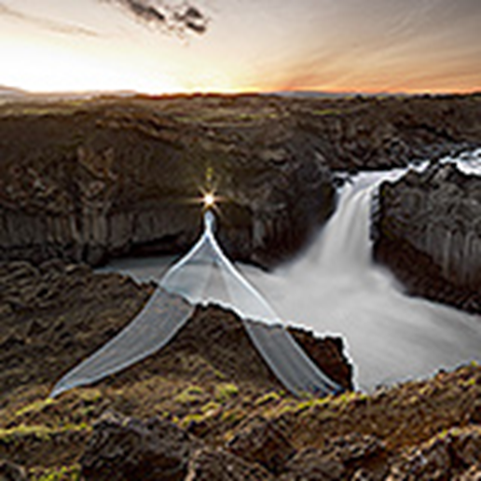
AldeyJarfoss, Iceland
One of the most interesting features of the waterfall is the contrast between the black basalt columns and the white waters of the fall.
turning night into day with flashlights and torches set their lightpaintings in unusual landscapes.
My thoughts on this picture is when the photographer took this they were on top of rocks and with a tripod.

Slide 3
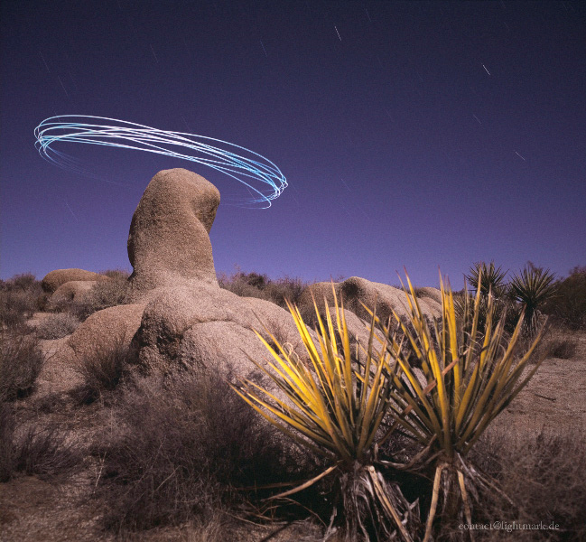
Joshua Tree National Park, California
The rock formations of Joshua Tree National Park were formed 100 million years ago from the cooling of magma beneath the surface.
The erosional and weathering processes of the present are only particularly responsible for the spectacular sculpturing of the rocks.
My thoughts on this photograph is the photographer took it from an angle upward and had someone swing the light figure from on top of the rock.

Slide 4
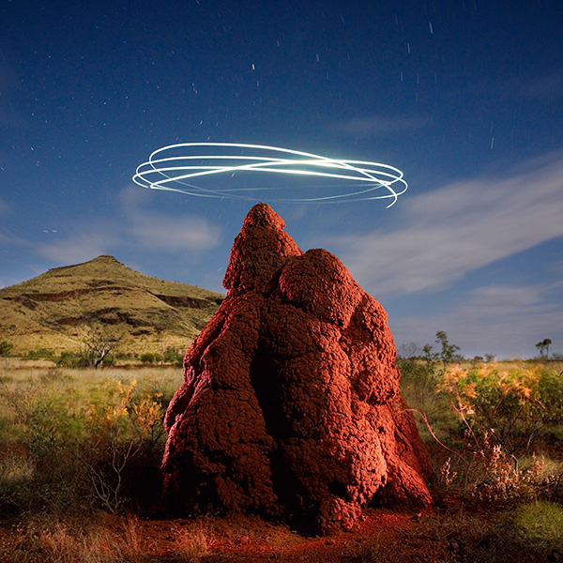
Karijini National Park, Western Australia

Slide 5
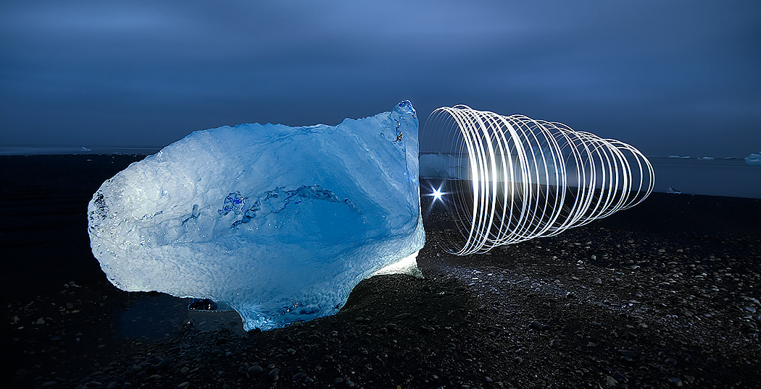
Vatnajökull National Park, Iceland.

Slide 6
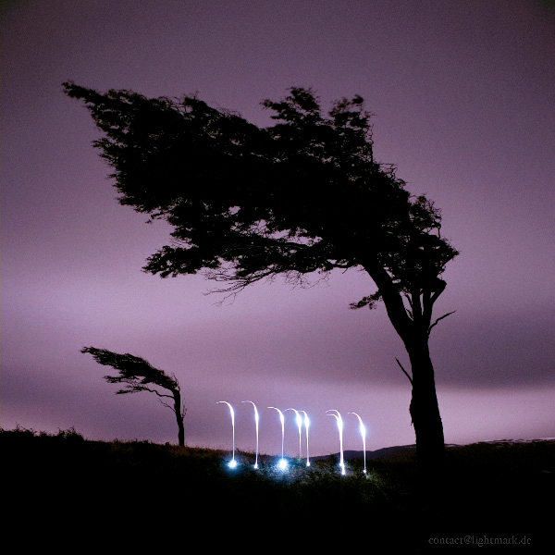
Provincia Tierra del Fuego, Argentina

