Slide 1
Light painting research assignment
By: Shaniece Woodbury

Slide 2
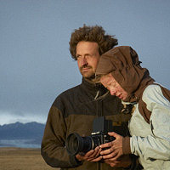
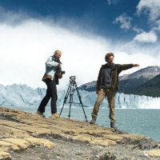
Cenci Goepel and Jens Warnecke

Slide 3
. The setting seems very calm, and has a small intentional blur.
.This was taken with a tripod
. They were using a slow shutter speed
, This image has frame, and lines
My thoughts: I enjoy this picture because its very peaceful and gorgeous.

Slide 4
. This picture is very dramatic and shows a lot of texture
. The shutter speed was slow
. This was not taking with a tripod.
. With a low iso
My thoughts: This is a very exciting photo. The texture is amazing, and it tells a story in a way. It makes you really think about what's going on.

Slide 5
. Three-hour uphill hike on a frozen path to reach the foot of the glacier
. Its a slow shutter speed while someone waves a light in constant circles
. There is a lot of texture and different examples of lines
My thoughts: This picture really caught my attention, Its very bright and happy.

Slide 6
. Slow shutter speed, high iso
. Attentional blur and texture
. Taken with a tri pod
. Some example of lines
My thoughts: This is my absolute favorite artwork, Its very dramatic and beautiful. The lighting was beautiful, and the image was well put together.

