Slide 1
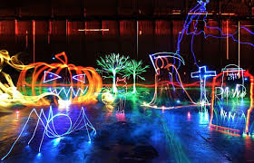
Light Painting Research
Shayla Alexander

Slide 2
Jeremy Jackson
Jeremy Jackson is also called “tacky”. He loves doing light paintings. He lives in the Blue Ridge Mountains of Virginia. He began to do light painting since 2008, and it has became a hobby to him since then.

Slide 3
Techniques/ The Process
He uses long exposure and the manipulation of various light sources, and he doesn’t use Photoshop unless he is cropping or rotating it.
He says “The light is the brush and the environment is the canvas determined by space and time.”

Slide 4
Inspiration
He is inspired by Dr.Suess, M.C. Escher, comic books and countless geometric designs and patterns.

Slide 5
My Thoughts
I think that Jeremy Jackson’s work is inspiring and that he is devoted into doing light paintings. His light paintings are amazing and he takes his time to do it.

Slide 6
