Slide 1
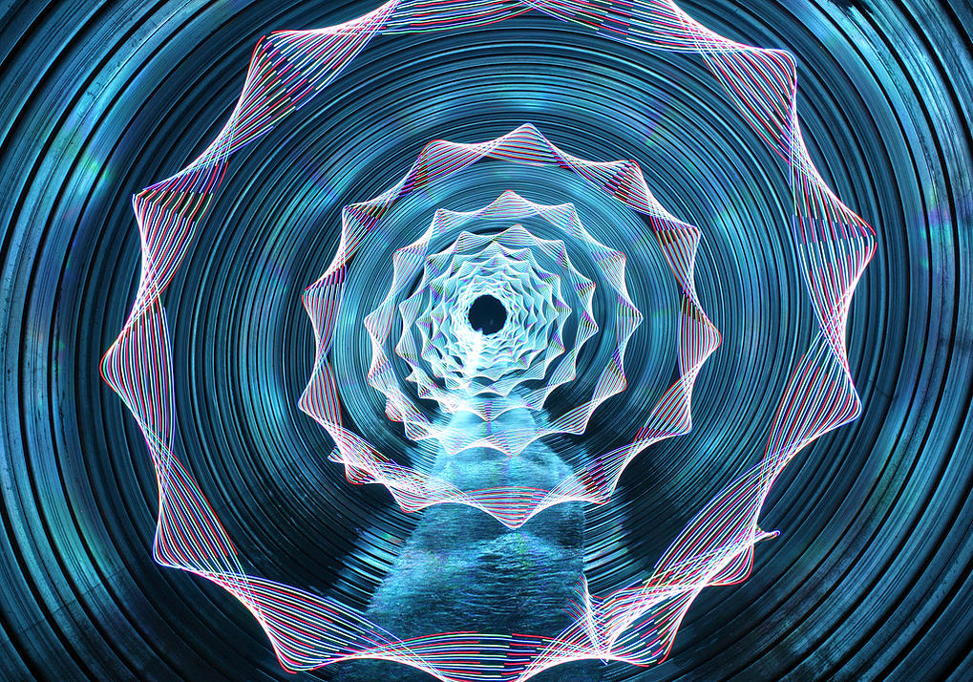
Light Painting Research
By:Zhamerah Newton

Slide 2
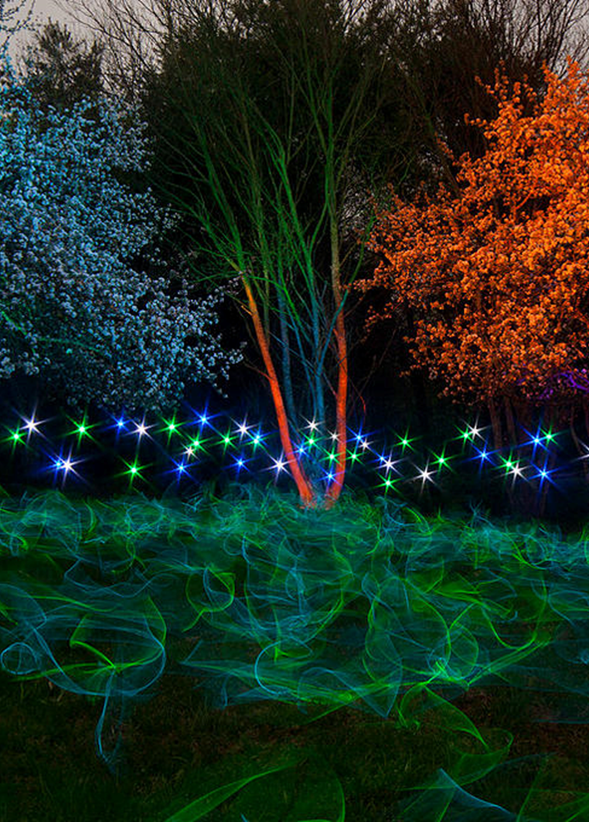
My Thoughts
Jermey Jackson’s light painting photographs are nice, I like them all, but I wonder how he does most of his photographs?

Slide 3
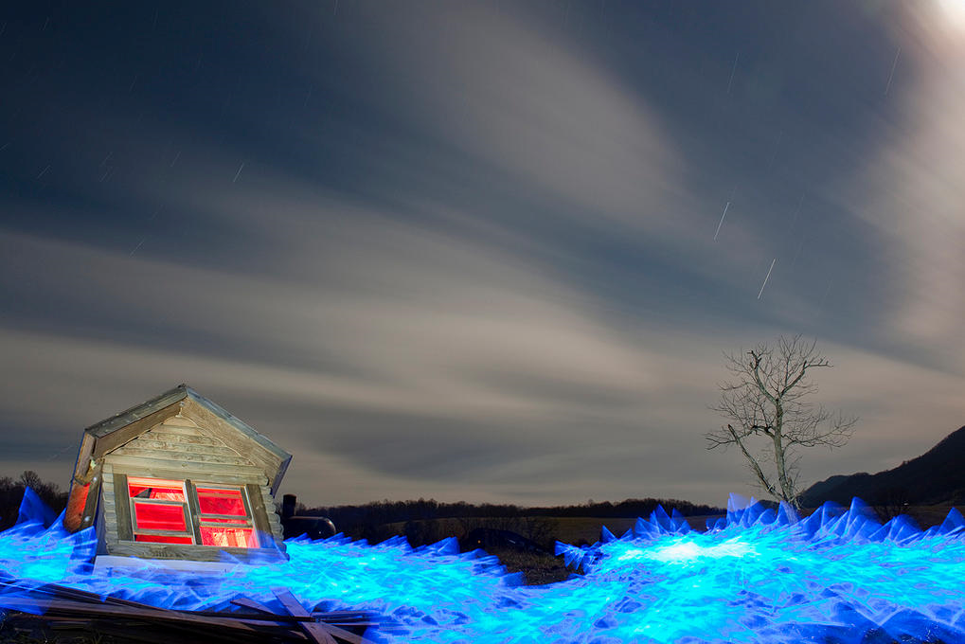
Tsunami

Slide 4
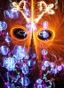
Jeremy Jackson
Well known for creating his “Fire and Light Masks”.
Only been light painting since 2007 but in that time he has put in more work and created more images than light painters that have been shooting twice as long.
Tackyshack explains light painting like this, “The world is your canvas. Anything you can imagine can be painted a million different ways, time and space take on new meaning”.

Slide 5
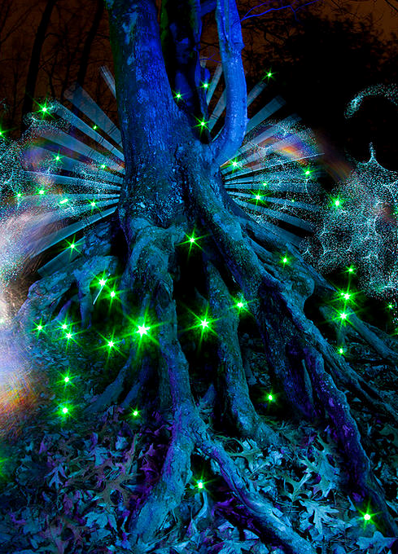
Details about the process
While it is tempting to believe that these images are merely experiments with Photoshop, Jackson achieves each one using only his camera, a wide spectrum of light sources, and his own seemingly limitless imagination. The end result is nothing short of astonishing, revealing a dazzling, four-dimensional univers that defies rational thought. Those curious about this artist and his fascinating process can read an in-depth interview here. He's also uploaded tons of great photos on Flickr.
http://fineprintnyc.com/blog/the-epic-light-paintings-of-jeremy-jackson

