Slide 1
Light Painting
Carolina Valverde
Block 3B

Slide 2
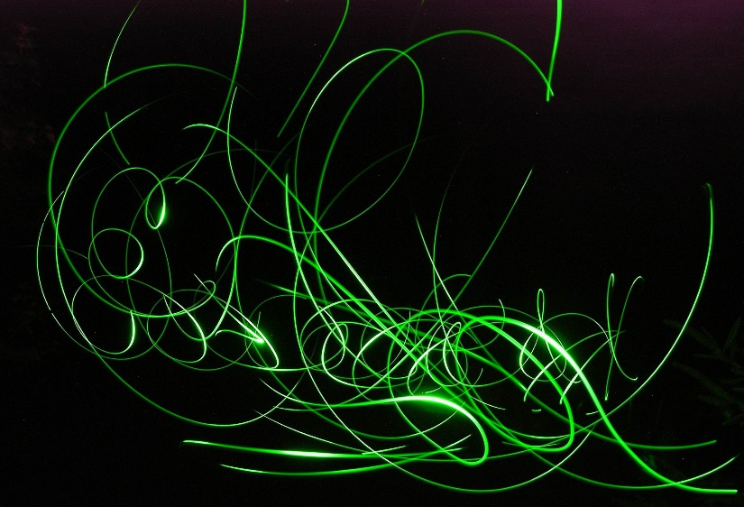
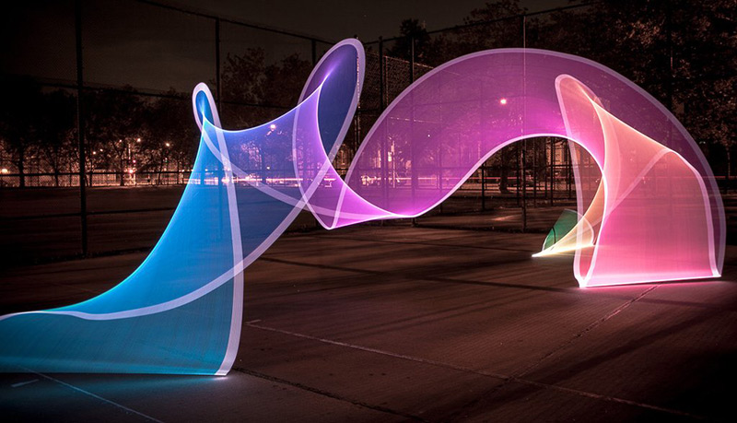
What is light painting?
Light painting is a photographic technique made by moving light sources while taking a long exposure photograph.
https://upload.wikimedia.org/wikipedia/commons/e/ec/Light_painting.jpg
http://www.thisiscolossal.com/wp-content/uploads/2013/10/pixel-2.jpg

Slide 3
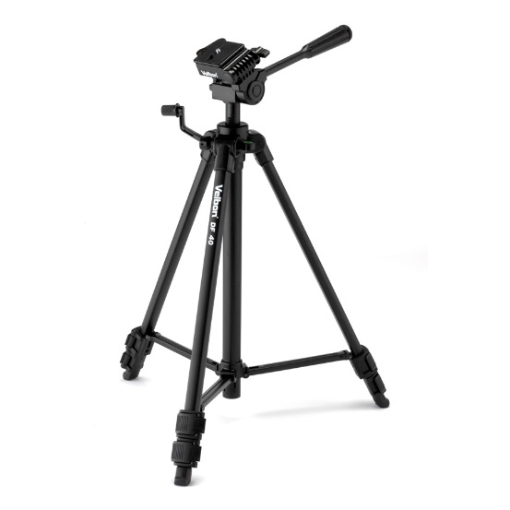
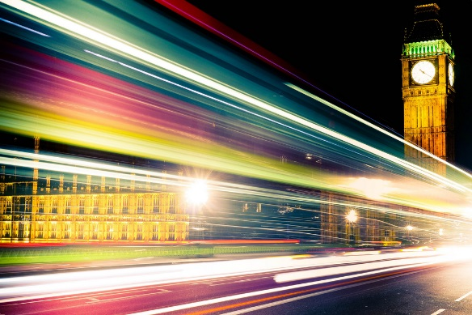
How is it made?
To prevent unwanted blur, light painting requires you to use a tripod with you camera.
Light painting is also done with a slow shutter speed setting. Usually this means a shutter speed of more than 1 second.
http://az163874.vo.msecnd.net/143c9f515cff4d86ab6f0969faac3792/Images/Products10137-1300x1300-418683.jpg
http://1.bp.blogspot.com/-H1qupFmhYOQ/UDH-Rp9Wt0I/AAAAAAAAB-8/4ixlXSYfC4k/s1600/shutter-speed.jpg

Slide 4
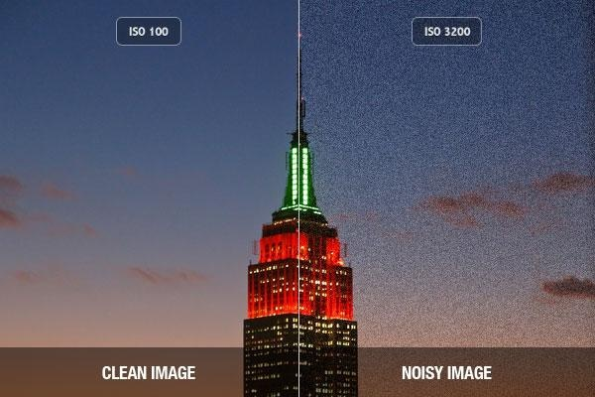
Light painting typically is done in dark environments. When you photograph in poorly lit places, you are supposed to use a higher ISO. However, in light painting, because the exposure is so long, more light is let in, and that may brighten the photograph too much.
To prevent this, you will have to use a lower ISO. This may be around an ISO of 300. By using a lower ISO, you can also eliminate background noise and distractions.

Slide 5
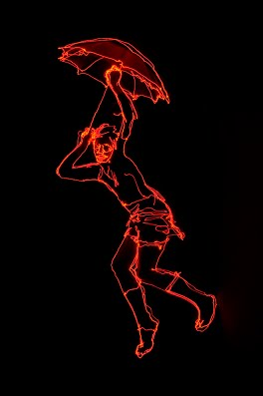
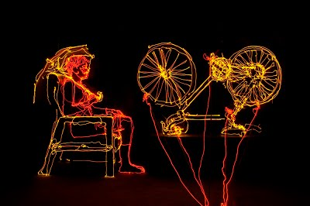
Brian Matthew Hart
Brian Hart is a photographer who makes very intricate light paintings that are unlike any I’ve seen.
https://sites.google.com/site/brianmatthewhart/_/rsrc/1319165609697/recentextrapolations/dena%20falling%20with%20umbrella%20light%20drawing.jpg?height=400&width=264
https://sites.google.com/site/brianmatthewhart/_/rsrc/1319166233281/recentextrapolations/absurdist%20portrait%20of%20dena%20with%20bike%20light%20drawing.jpg?height=266&width=400

Slide 6
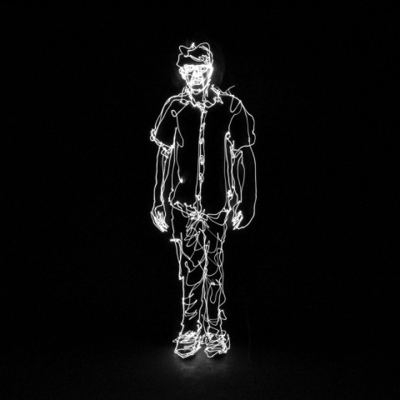
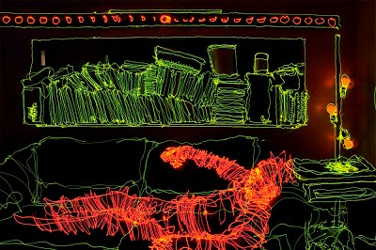
Brian uses a shutter speed of more than just a few seconds. Some of his photos use an exposure of more than 20 minutes, so he can capture as much detail as he can.
https://sites.google.com/site/brianmatthewhart/_/rsrc/1319165405669/recentextrapolations/laying%20on%20the%20couch%20without%20dena%20apt%20light%20drawing.jpg?height=266&width=400
http://www.mnartists.org/sites/default/files/styles/artist-profile-photo/public/pictures/picture-650-1405550308.jpg?itok=a-h1abKV

Slide 7
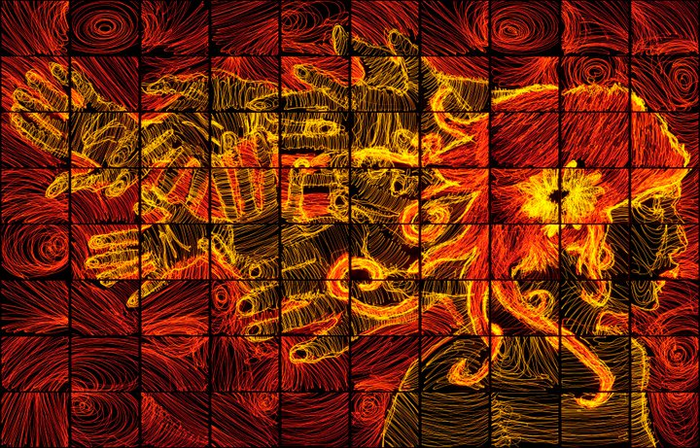
My favorites are his mosaics. In these particular pieces he puts multiple photos together to create a larger picture.
http://lightpaintingphotography.com/wp-content/uploads/2011/11/Brian-Hart-15.jpg

Slide 8
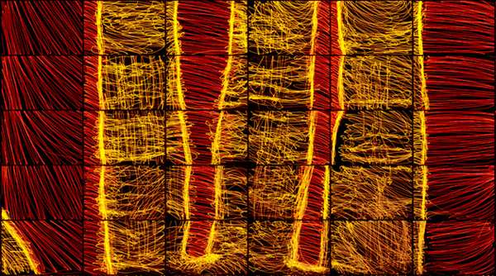
This piece is made up of 324 individual light paintings photographed by Hart.
https://sites.google.com/site/brianmatthewhart/_/rsrc/1336341917303/recentextrapolations/right%20hand%20contact%20sheet%20mockup%202000.jpg?height=400&width=264
http://cdn.trendhunterstatic.com/thumbs/hand-series-by-brian-matthew-hart.jpeg

Slide 9
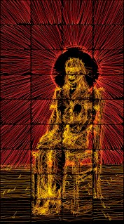
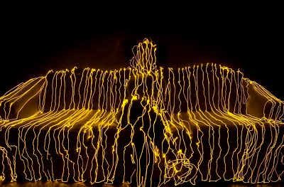
More photos by Brian Hart

