Slide 1
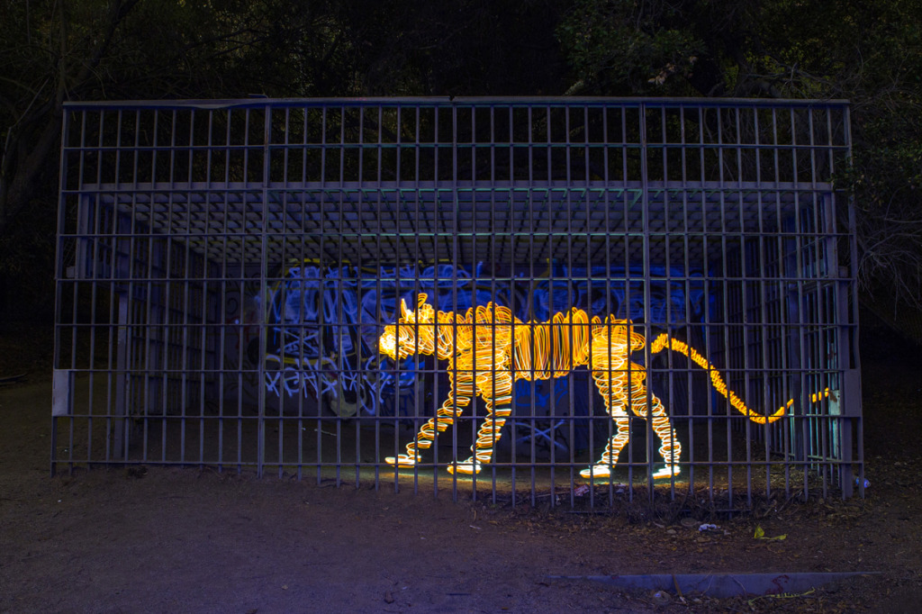
Light Painting
BY: Ashley Stewart

Slide 2
Darren Pearson's Photography

Slide 3
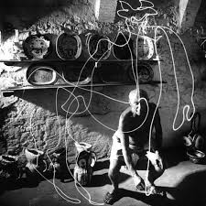
Details about the photography
He started doing his light painting in 2008 and hasn’t gotten tired of doing them. His influence was Pablo's Picasso’s light drawing “ Picasso Draws a Centar”. To create his light sculptures, Darren uses long-exposure photography, by slowing down the shutter speed so its able to take in light.

Slide 4
Details about the process
Darren Pearson developed his light painting techniques on spinning a glass prism in front of a camera while shining a light into the lens. He blends two pictures together to create a series of pictures whether for water pictures or any other of his other light sculptures.
He usually waits until about dusk time about he sets his camera onto a tripod. After that, he sets the cameras long exposure to 2-7 minutes, to set up and when the shutter is released he jumps in front of the camera and paints.

Slide 5
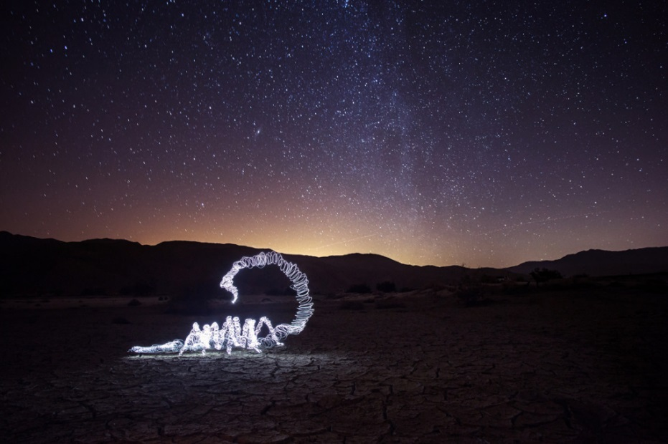
Thoughts on Darren's work
Darren's artwork is very ingenious and original. I love the way he describes it “our images outlive us”. He is very creative with his artwork as he takes these animals and brings them to life. I admire his artwork because he takes these captivating pictures and they blur the lines between fantasy and reality.

