Slide 1
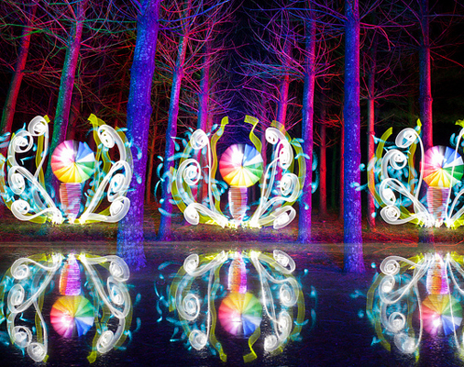
Jeremy Jackson
By: Imani Waheed

Slide 2
About Jeremy Jackson-
Jeremy Jackson AKA Tacky
Lives in Blue Ridge Mountains of Virginia
Light Painting Fanatic; Began in 2008
He is known for his “ Fire and Light Masks “ photographs

Slide 3
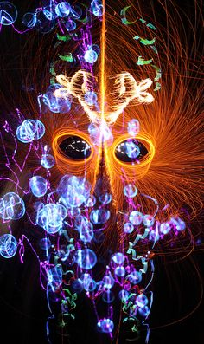
Fire and Light Mask #152- Best one because he was so creative in how he used his materials.

Slide 4
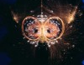
Fire and Light Mask #101- This picture is a great way to portray quality and not quantity.

Slide 5
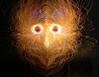
Fire and Light Mask #21- I like that Jeremy made a photo where there can be many different perceptions of what the photo can mean.

Slide 6
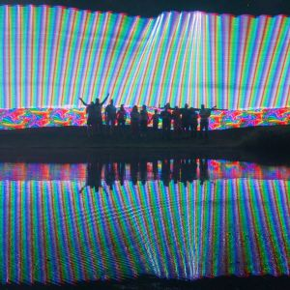
How Does He Do It?
In this photo, Jeremy waved 5 meter tall LEDs behind his family and friends.

Slide 7
Citations-
Light Painting Photography. N.p., n.d. Web.
"Tackyshack Light Painting." Tackyshack Light Painting. N.p., n.d. Web. 02 Nov. 2015.
"10 Amazing Light Painting Photographers You Should Start Following Right Now." PetaPixel RSS. N.p., 27 Aug. 2013. Web. 02 Nov. 2015.

