Slide 1
Janne Parviainen
- Donisha Riddick

Slide 2
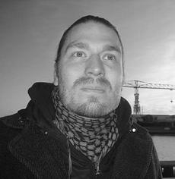
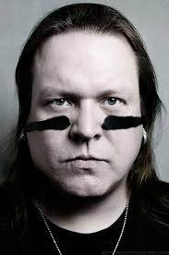
About janne parviainen
Been snapping photographs for over 15 years
His discover of the medium was a accident
he was out one night capturing a long exposure photograph and he accidently bumped his camera and from then on he has been making light paintings
He produces ghost and skeleton
his favorite thing about light painting is urban exploration , and the constant source of inspiration that it provides him

Slide 3
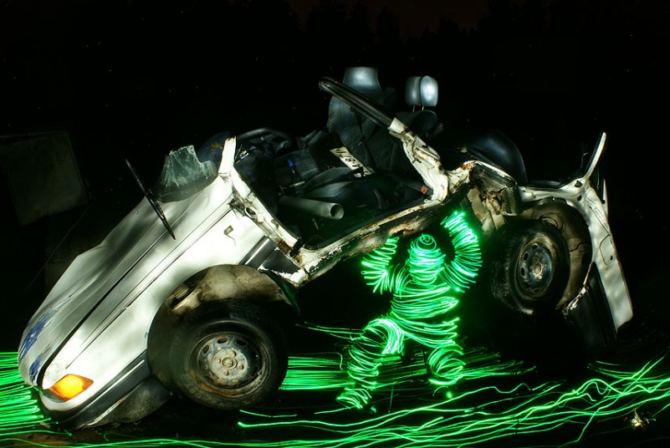
His technique
His exposure times used in light painting vary from a few seconds to hours, depending on the desired effect. The actual light painting can be done with colored strobes, flash lights, light toys or tools especially engineered for light painting
He loves to use humane characters in his photos.
“ These light figures have been in my light painting photos since the day I started and have evolved from ghostly light creatures to skeletons made of light and mystical characters dripping with light. “

Slide 4
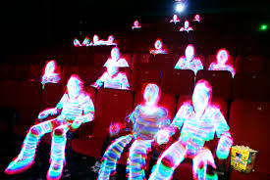
Sit back and observe
http://jannepaint.wix.com/jannepaint-2#!landscapes/ck0q

Slide 5
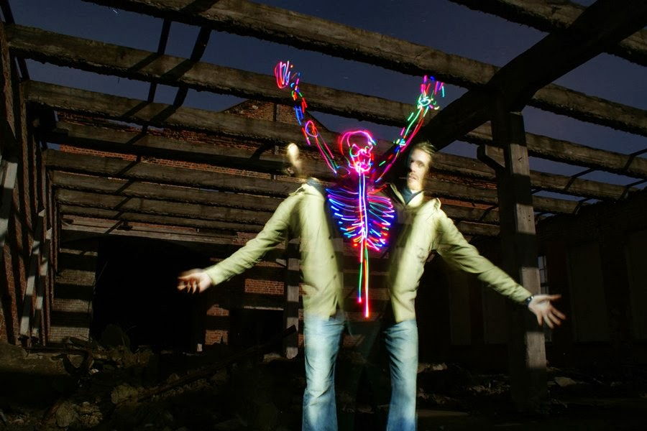
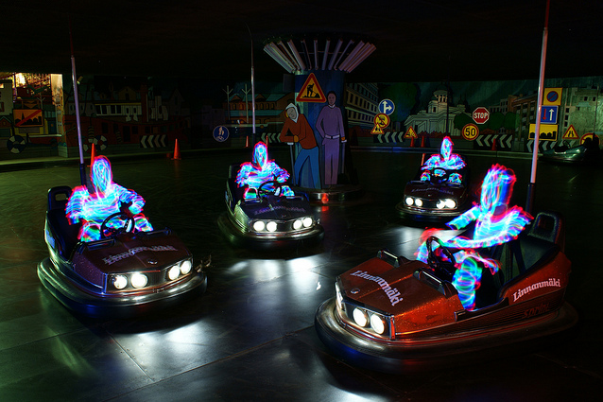
He includes ghost and skeletons in all his pictures

Slide 6
My thoughts
I think his theme in his light painting pictures and very unique and different , he uses skeletons and ghost to express his feeling towards them

