Slide 1
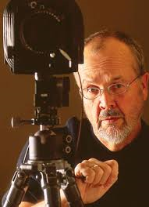
Jack W. Dykinga
By: Aiyana Rudolph

Slide 2
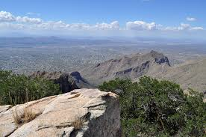
Background
Full Name: Jack William Dykinga
Born on January 2, 1943 in Chicago, Illinois
Currently lives in Tucson, Arizona with his wife
Specializes in Landscape photography

Slide 3
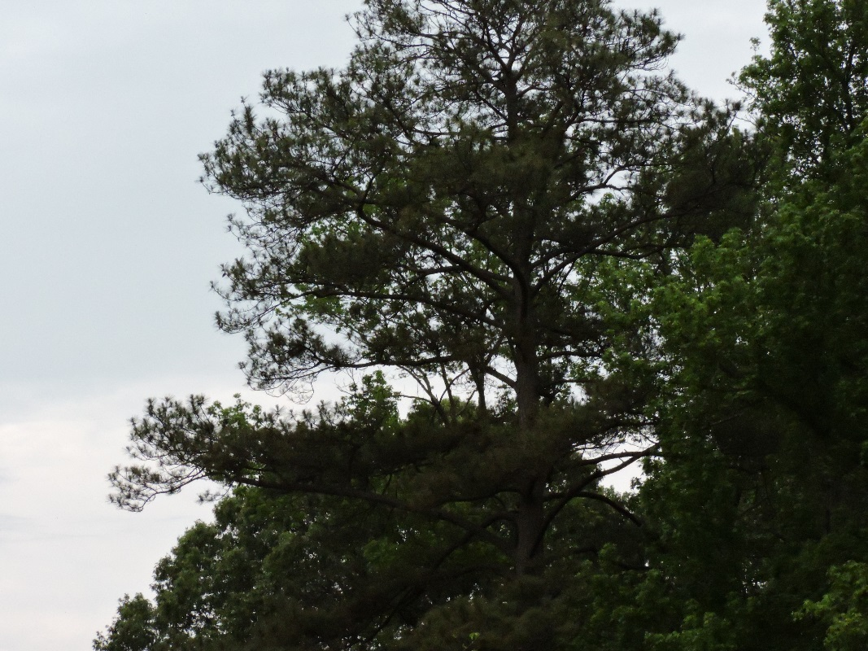
Timeline
1970: Worked with the Chicago sun times and won the annual Pulitzer prize for feature photography
1987: Frog Mountain Blues
1992: The Sonoran Desert
1993: The Secret Forest
1996: Stone Canyons of the Colorado Plateau
1998: The Sierra Pinacate
1999: Desert
2001: Large Format Nature Photography
2004: Jack Dykinga’s Arizona
2008: Jack Dykinga’s Grand Canyon
2013: Capture the magic, train the eye, improve your photographic composition

Slide 4
