Slide 1
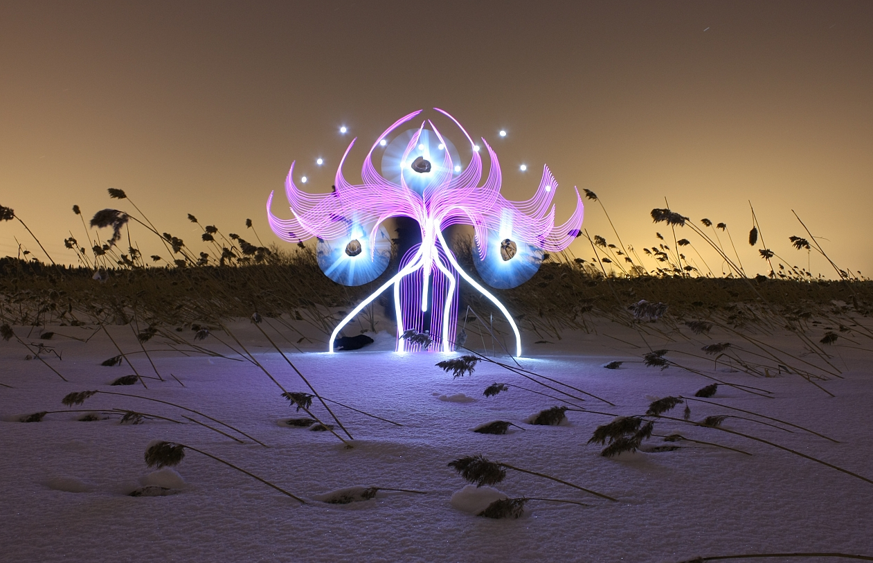
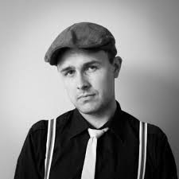
Hannu Huhtamo
Digital Photography PowerPoint Presentation
By: Alex Gregoriou

Slide 2
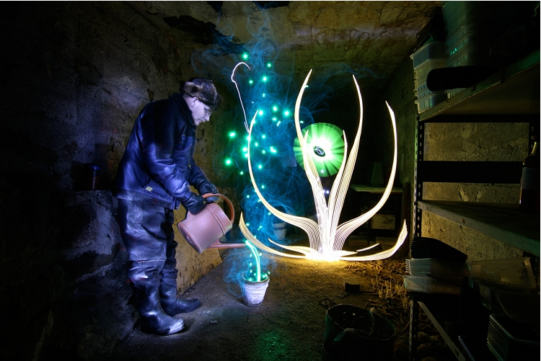
About the Photographer
Has been light painting since 2008
His first light painting was in the 1990’s when he was in a death metal band. He wanted to draw a pentagram with a lighter so he opened the shutter of his camera and found something that inspired him.
Huhtamo is a solo artist, but sometimes he collaborate with another LP artist, Janne Parviainen a.k.a Jannepaint.

Slide 3
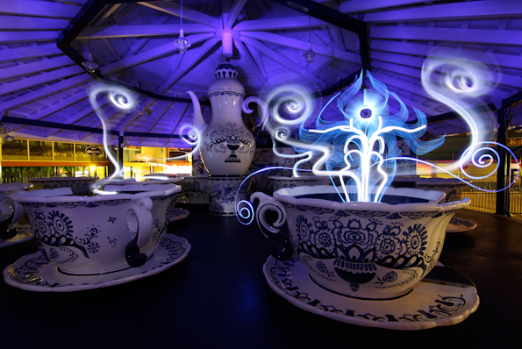
Details about the Photography
Hannu’s work focuses on organic forms, more specifically he draws amazingly beautiful flowers.
Hannu hates the dreaded word Photoshop and is a firm believer that all light painting images should be SOOC, (straight out of camera).

Slide 4
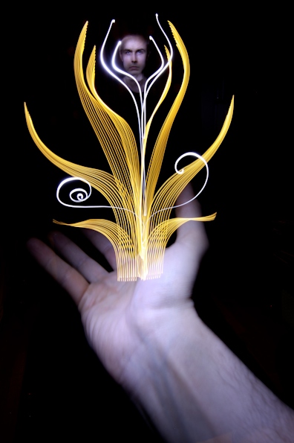
Details about the Process
“Darkness is the canvas and light is my brush.”
“Like many others, I get my best kicks from the nature. By contrast I also use a lot of urban landscapes and places in my work. For example ugly ruins of a house look much more beautiful and interesting after some light treatment. I keep my pictures as natural as it’s possible. No post editing, manipulation or digital effects (Photoshop etc.) are used. I think that’s where the magic is, at least for me.”
~Huhtamo
His photographs are based on long exposure times that could vary from a few seconds to hours.

Slide 5
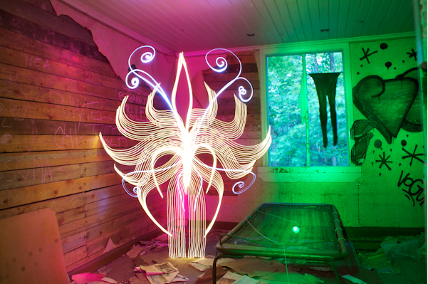

Slide 6
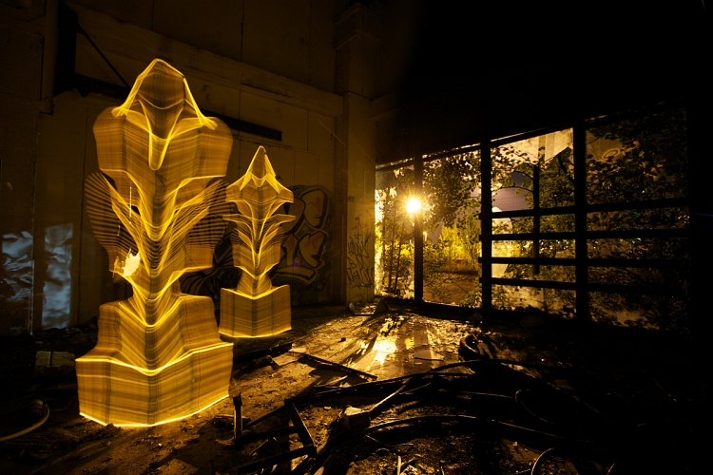

Slide 7
Thoughts on the Work
Huhtamo’s work so beautiful and whimsical.
I love the way he makes flowers out of light.
It’s a cool concept how he makes art out of old abandon houses and then calls it giving them a little “light treatment”.
I do wonder though how fast does he have the work in order to get the form of the flowers.
How does he make it so that light covers the floor in some of his pictures?

Slide 8
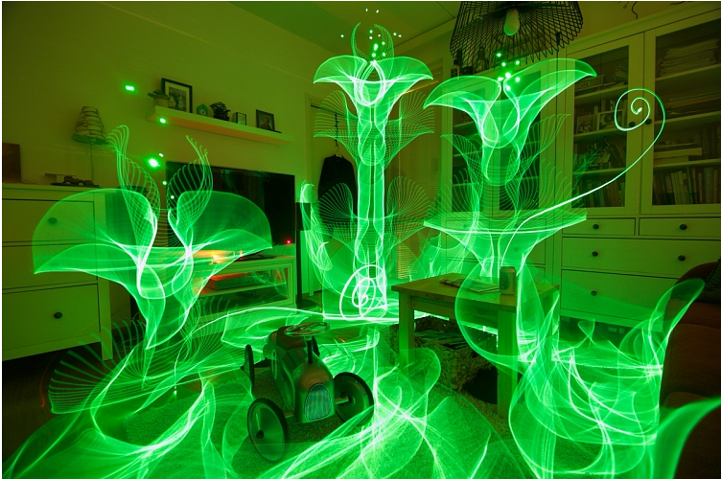

Slide 9
Mores Photos of Hannu Huhtamo’s Work

Slide 10
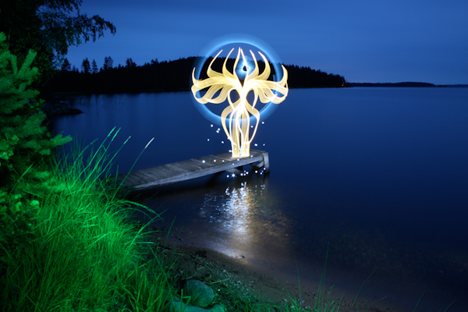

Slide 11
