Slide 1
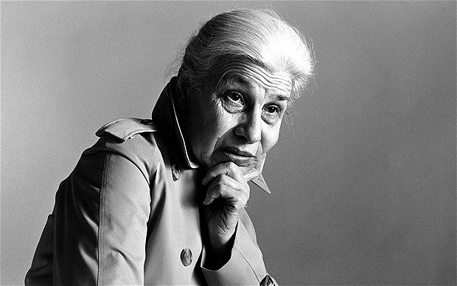
Eve Arnold American, 1912 - 2012
“If a photographer cares about the people before the lens and is compassionate, much is given. It is the photographer, not the camera, that is the instrument. ”
By: Alex Gregoriou

Slide 2
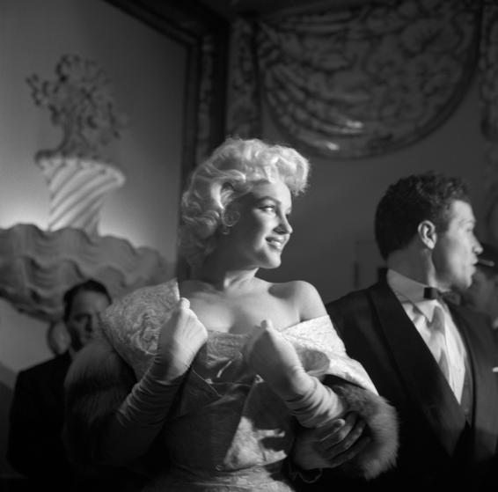
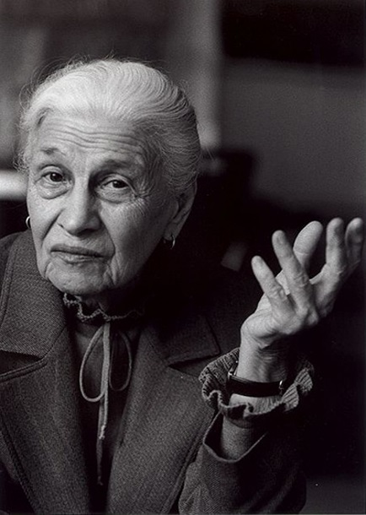
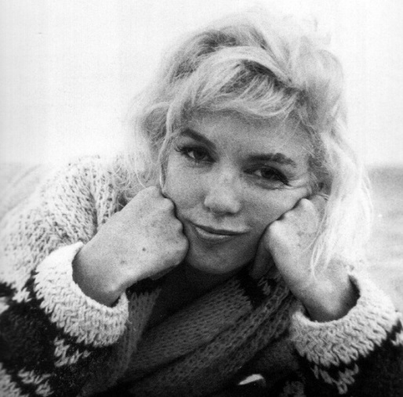
Who is Eve Arnold?
Born: April 21, 1912, Philadelphia, PA
Died: January 4, 2012, London, United Kingdom (at the age of 99)
A member of the famous Magnum Agency(an international photographic cooperative).
Arnold was perhaps best known for her sensitive images of Marilyn Monroe which were taken throughout the young actress’s career.

Slide 3
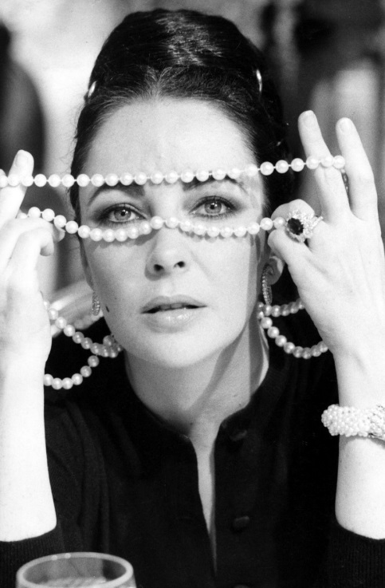
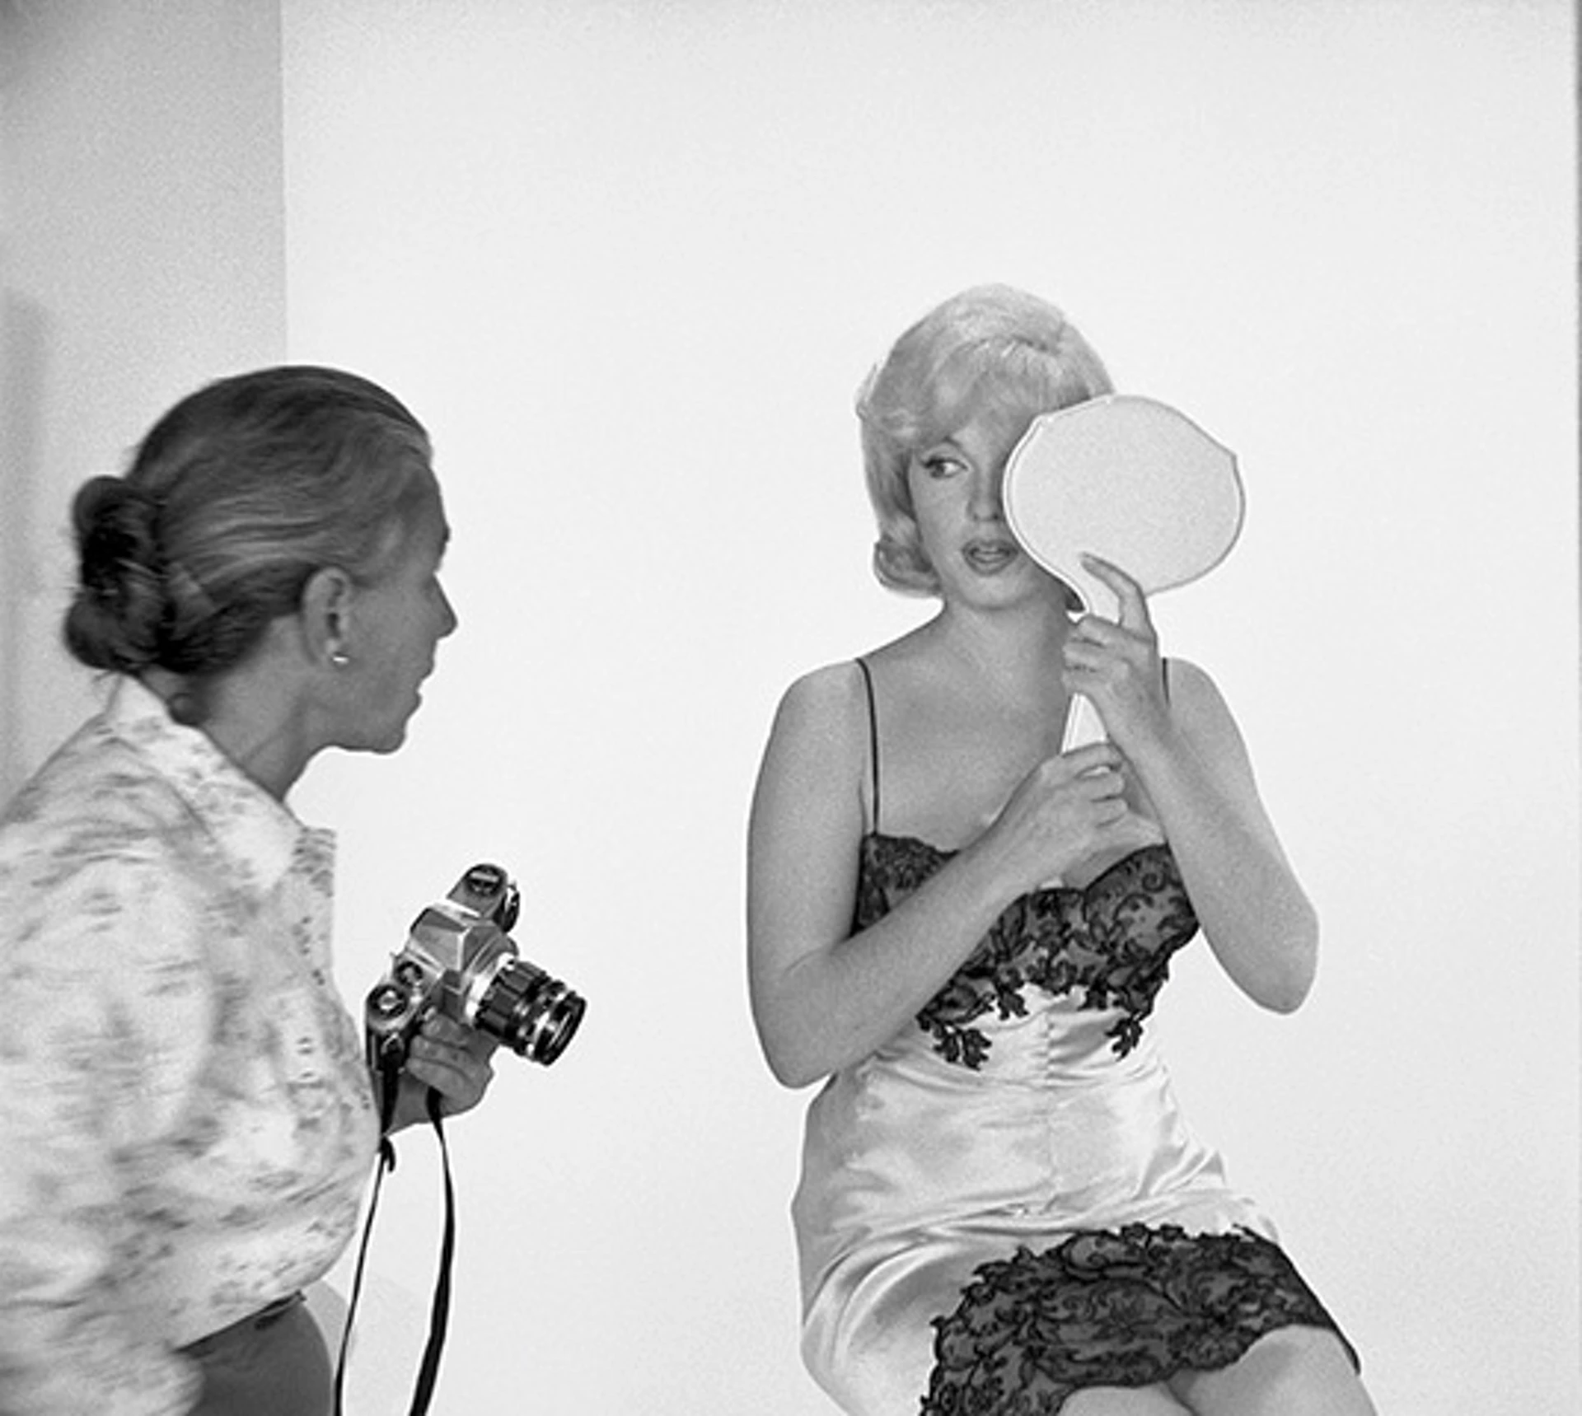
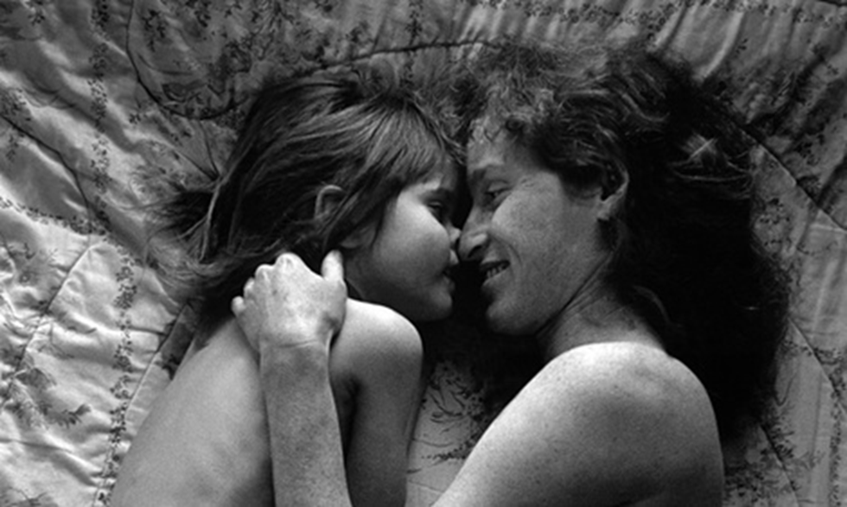
Type of Photography Produced
Photojournalism
Although most people know her for her photography of Monroe, Arnold was also well-known for her portrait photography.

Slide 4
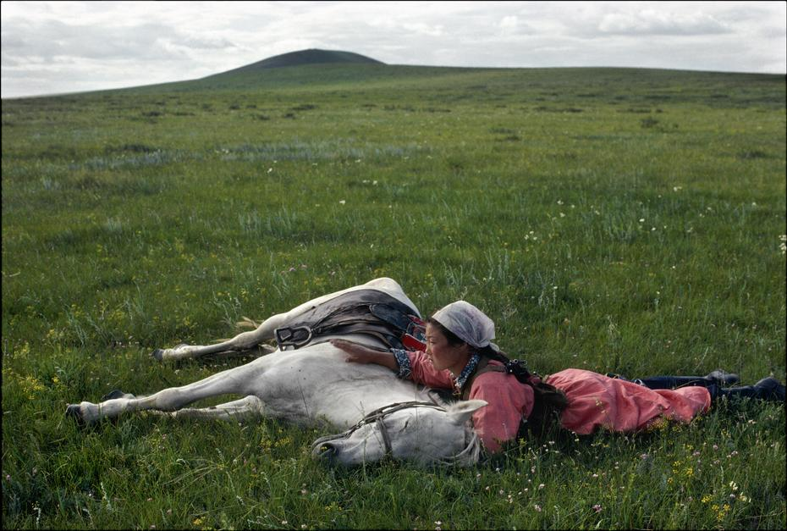
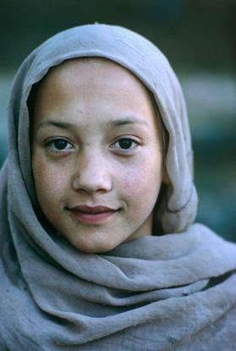
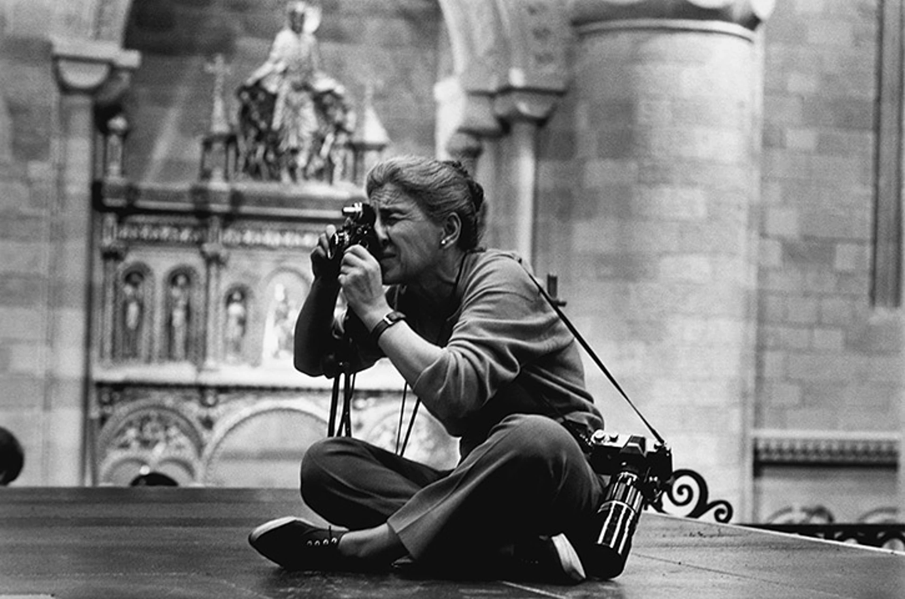
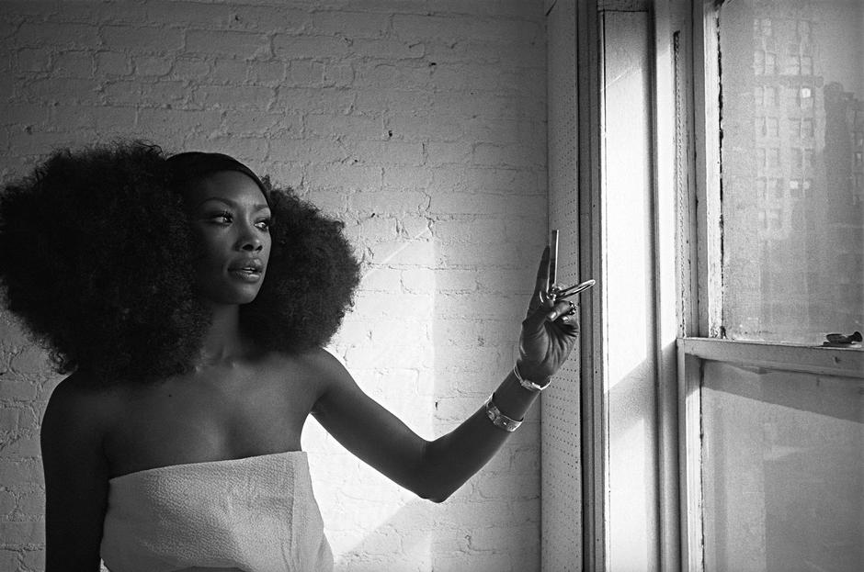
When & Where
Besides Monroe, Arnold also photographed Queen Elizabeth II, Malcolm X, and Joan Crawford. She has traveled around the world, photographing in China, Russia, South Africa and Afghanistan.
She was based in the U.S. during the 1950s but went to England in 1962 to put her son through school; then she decided to stay in England for the rest of her life and start colored photography all around the U.K.
In 1980, she had her first solo exhibition, which featured her work done in China at the Brooklyn Museum in New York City.

Slide 5
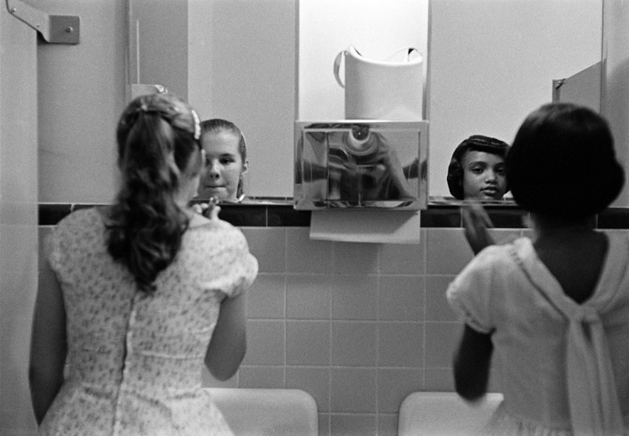
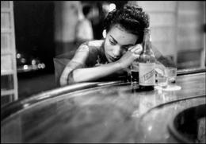
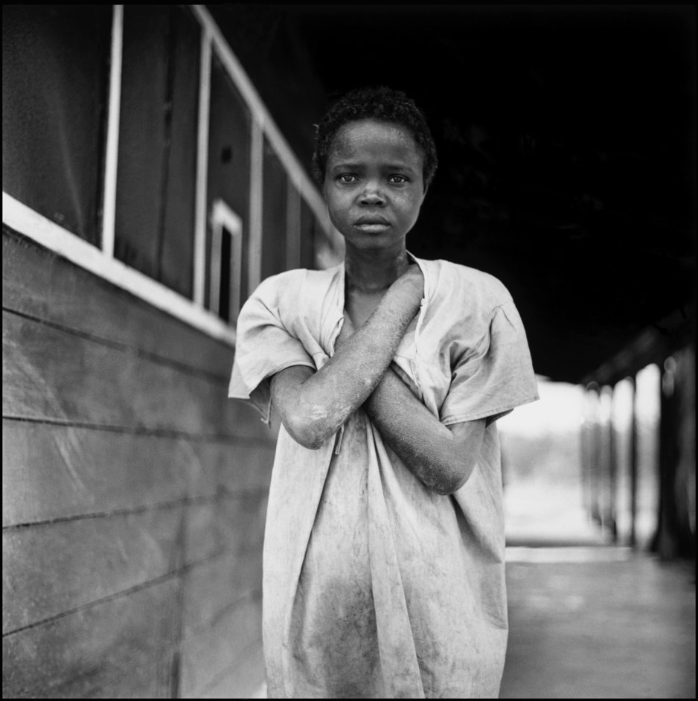
Why Create?
Arnold photographed many of the iconic figures who shaped the second half of the twentieth century.
Yet she was equally comfortable documenting the lives of the poor and homeless, “migrant workers, civil-rights protestors in South Africa, disabled Vietnam war veterans and Mongolian herdsmen.”
“"I don't see anybody as either ordinary or extraordinary," she said in a 1990 BBC interview, "I see them simply as people in front of my lens.”

Slide 6
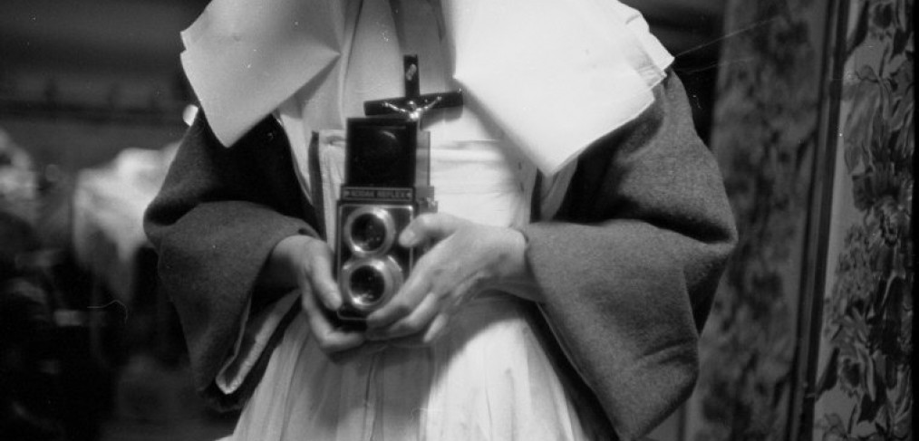
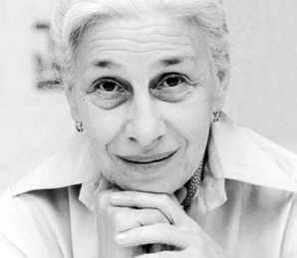
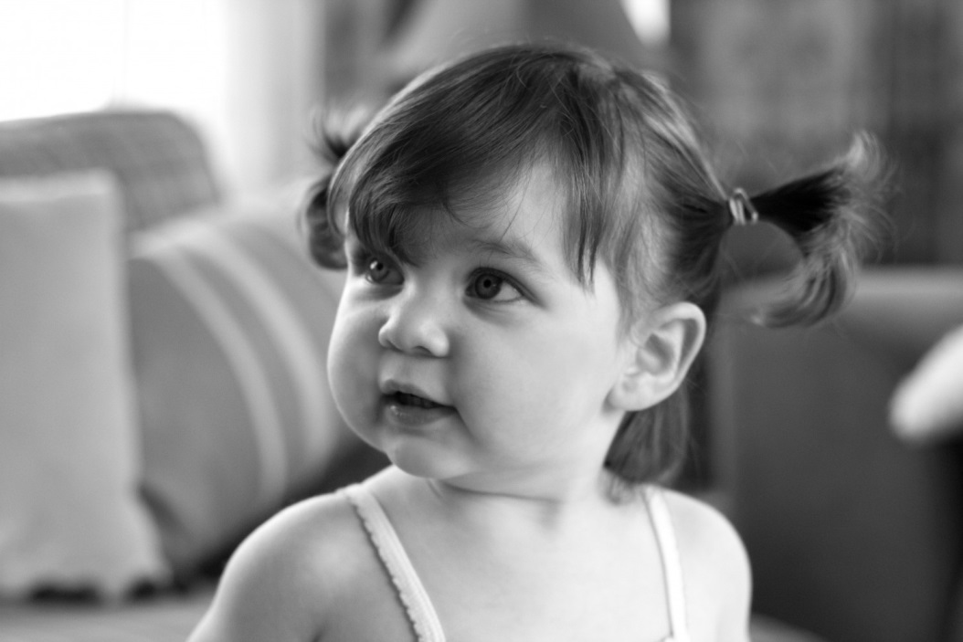
How?
She always worked with available light, concentrating on the image in the lens and avoiding extra photographic lighting and flash.
"By the time you set up lights the image is gone" she said at a Guardian interview in 2000.

Slide 7
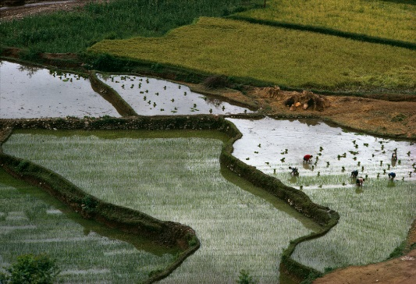
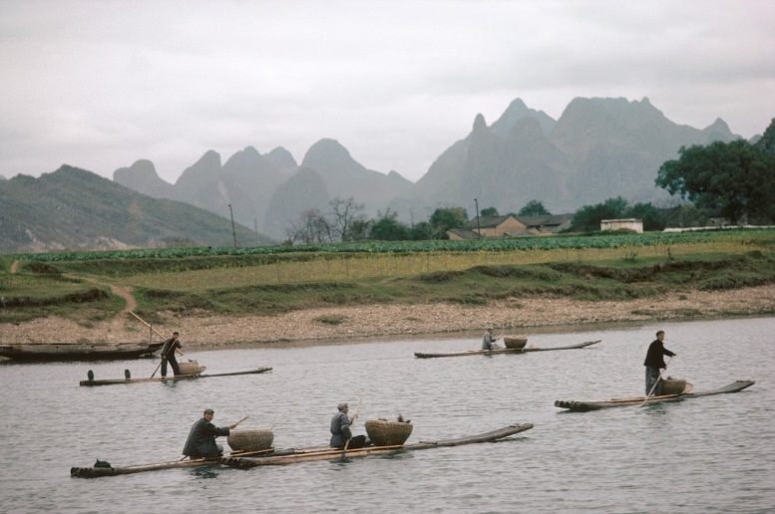
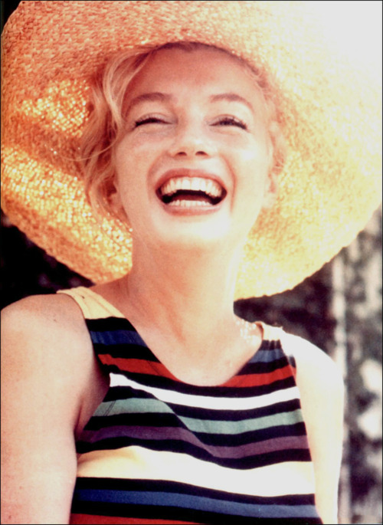
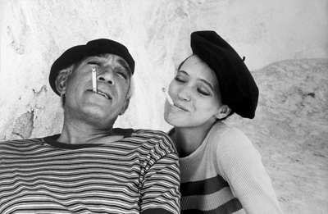
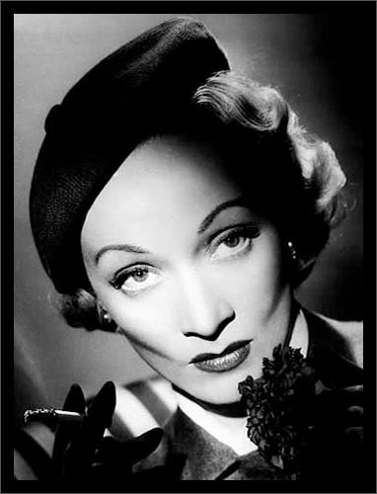
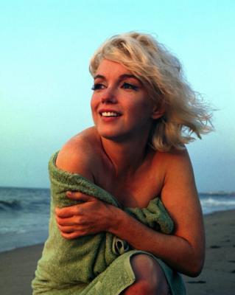
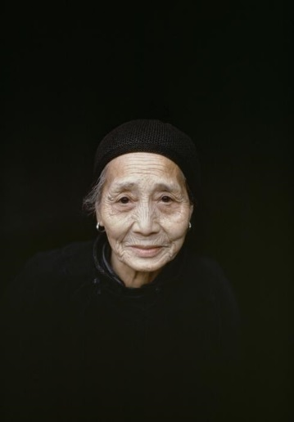
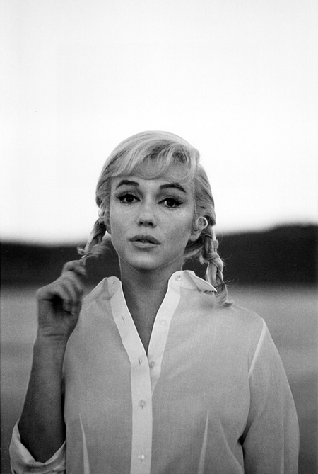
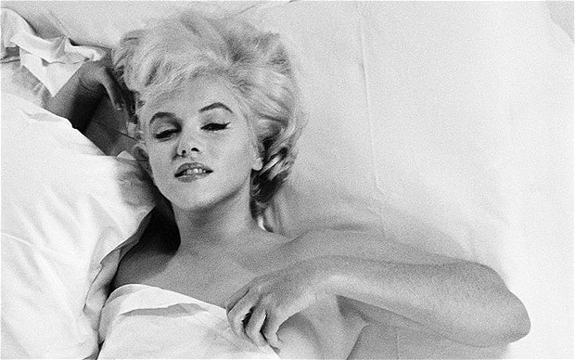
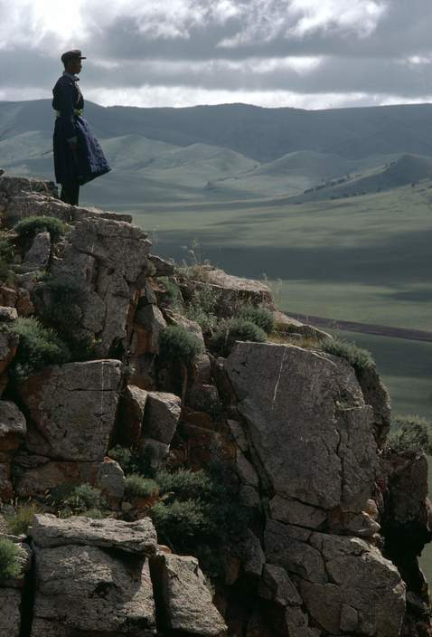
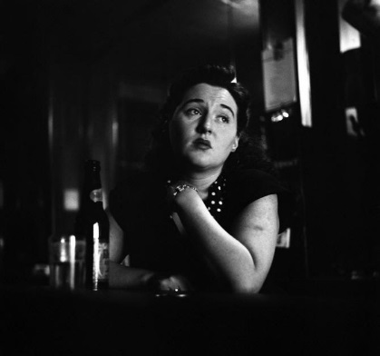
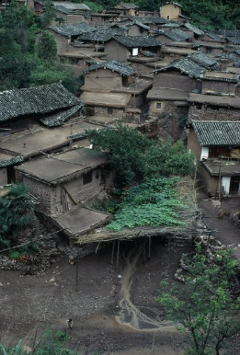
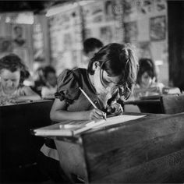
Arnold Gallery

Slide 8
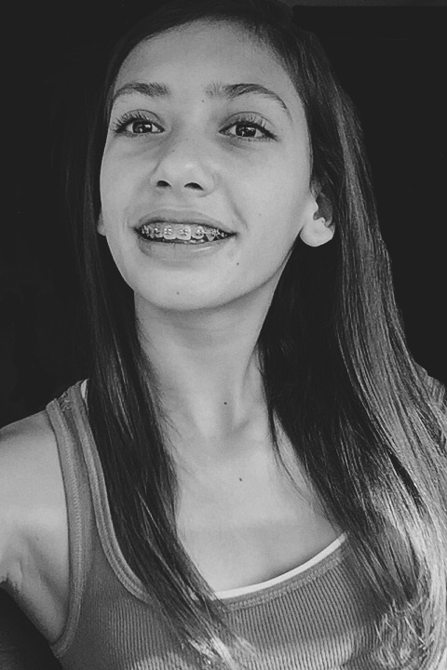
Inspired Photo

