Slide 1
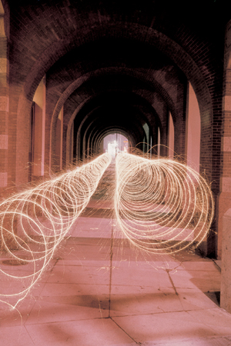
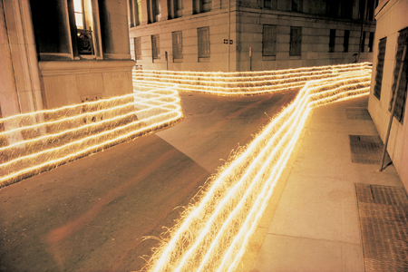
Eric Staller's Work By De’Asia Jones

Slide 2
POSEIDON By: Eric Staller
Process.
Positions The Tripod
Opens the Lens and sets camera for specific time
Puts many colorful light sources in different locations to capture photos

Slide 3
My Thoughts
I believe that the image was captured at perfect timing. The Iso has to be 400 or below considering that he took the photos outside and there is no real lighting. Also I believe the shutter speed was slow so it could seem like motion occurred.

