Slide 1
Light Painting Darren Pearson
By: Olivia Dayag

Slide 2
Darren Pearson

Slide 3
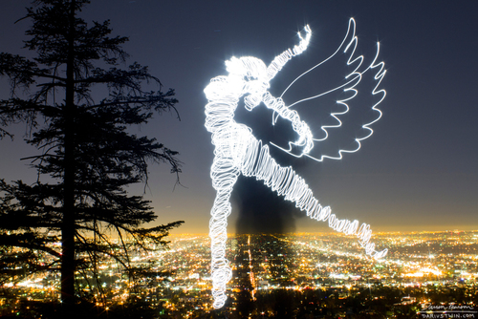
Details about the photography
Darren Pearson, a.k.a. Darius Twin, has been light painting since 2008. He currently lives in Los Angeles . Darren mostly paints live or moving figures incorporated into the environment he's photographing in.

Slide 4
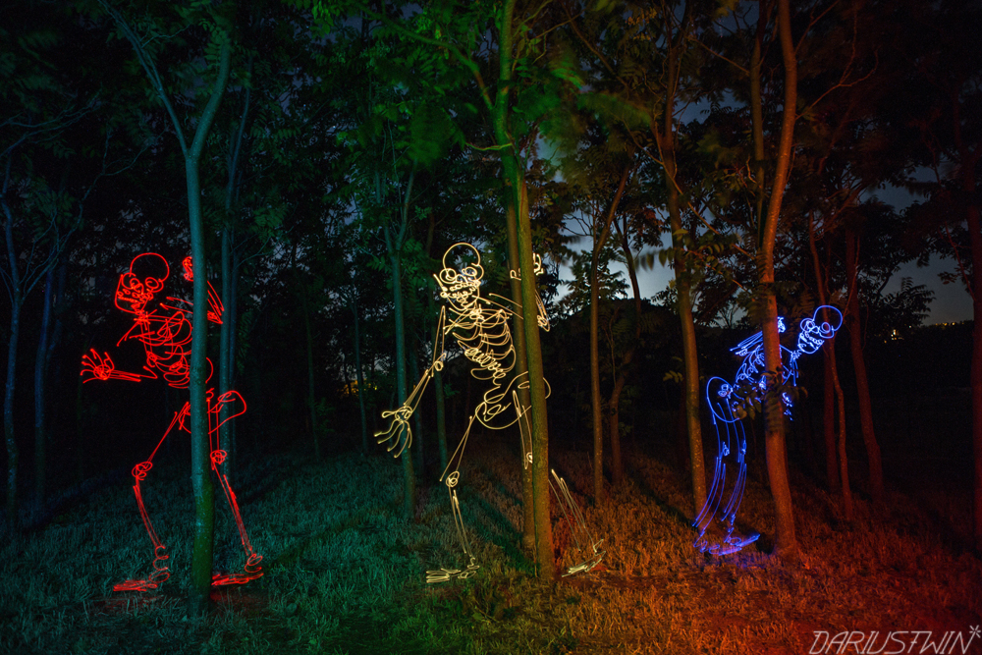
Details about the process
The process of light painting is to swing a light in front of a camera with a slow shutter speed and low ISO to make the path of the light look fluid and seamless. To create his light paintings Darren spins prism glasses over the lens of the camera while shining white lights into the lens to create rainbow prismatic circles. He was one of the first to do it this way and has helped pioneer the technique ever since.

Slide 5
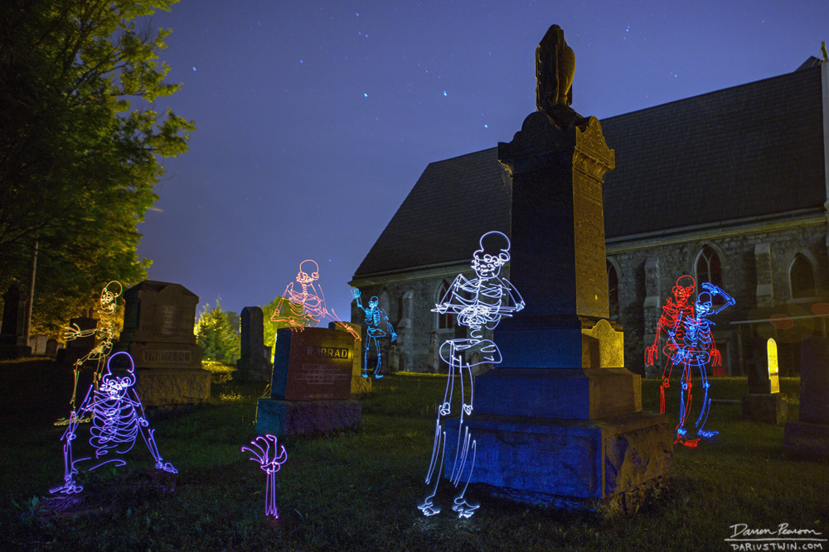
Thoughts on the work
I think that Darren’s take on light painting is different than any others that I’ve seen. The way that he makes the images is very innovative and creative. And the types of images he creates are different than any other. He can make scenes and tells stories through his pictures.

