Slide 1
Darren Pearson
Aaron Harrell

Slide 2
Biography
Darren Pearson, a.k.a. Darius Twin, is a Los Angeles light painter who was inspired by Gjon Mili capturing Pablo Picasso light painting. The piece that inspired Pearson was “Picasso Draws a Centaur”. This inspired Pearson’s technique by using Night-Writers and a background featuring an environment. He also pioneered the technique of spinning a glass prism in front of a camera lens to create a prismatic rainbow effect.

Slide 3
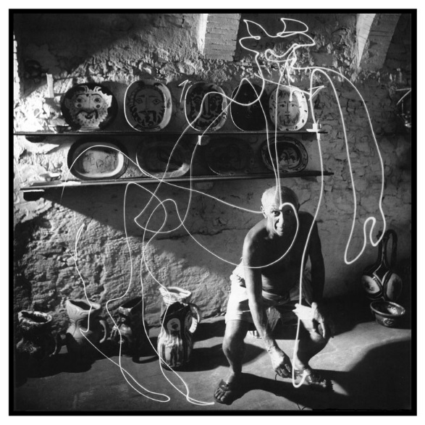
“Picasso draws a Centaur” - Gjon Mili ,1949

Slide 4
Process

Slide 5
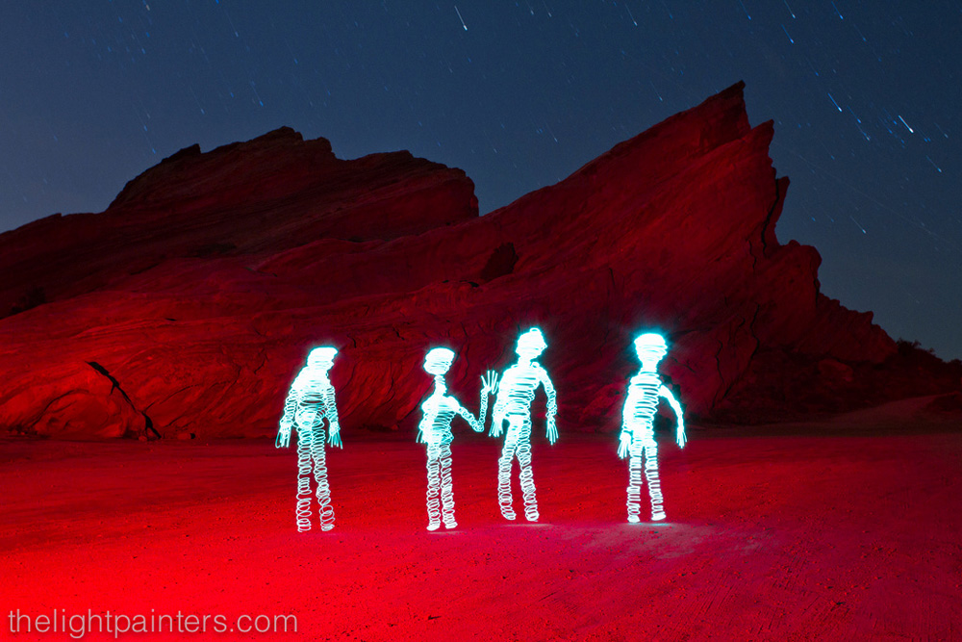
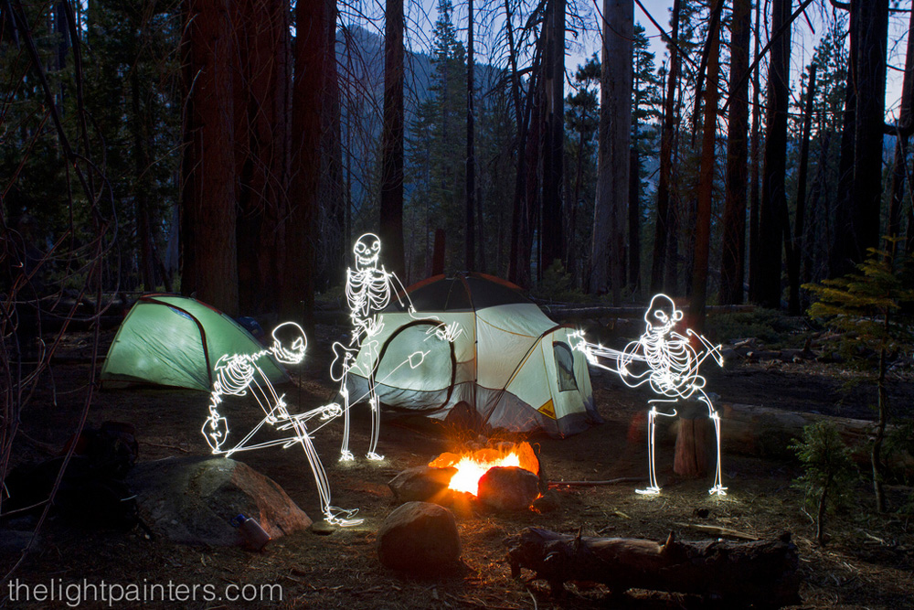

Slide 6
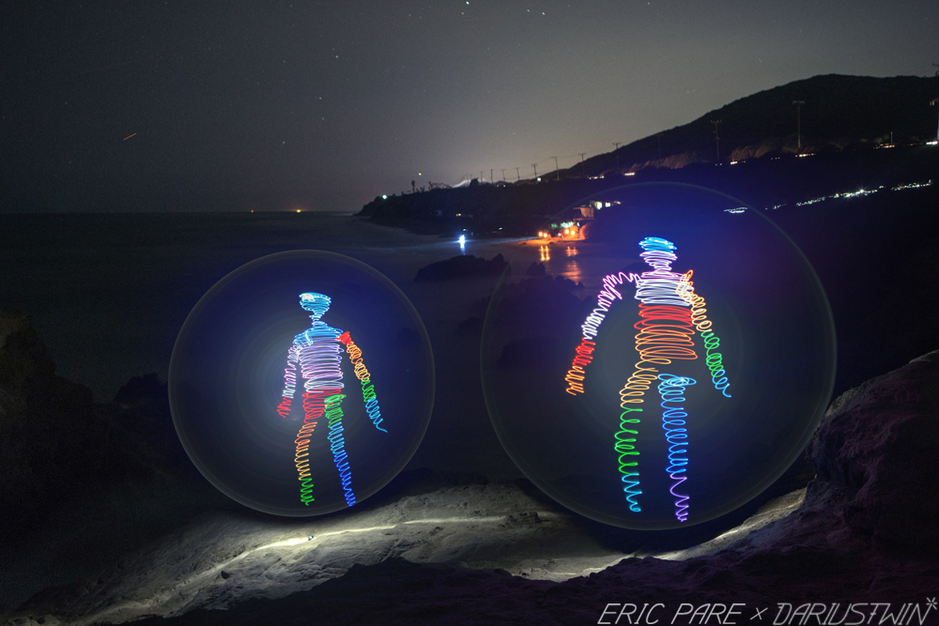
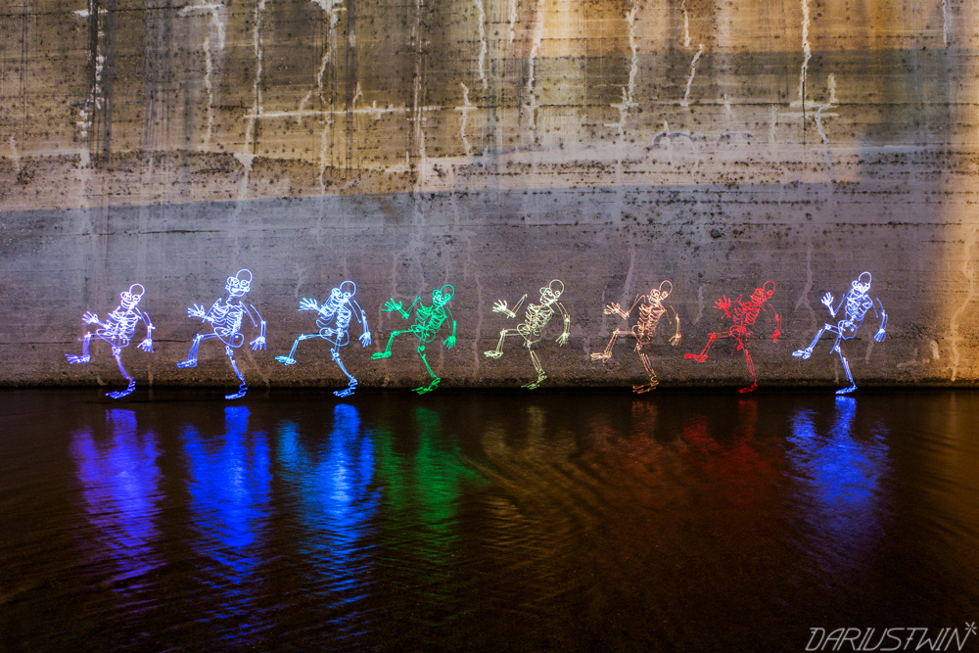
River Dance
Atmos Spheres

Slide 7
About Pearson's work
His work is creative and captures the attention of the audience
He is able to create and capture light paintings in natural environments without capturing himself in the photo.
Overall, Pearson’s work shows how light painters can become creative with their work and

