Slide 1
Dana Maltby light painting
By: Jeffery Chappell

Slide 2
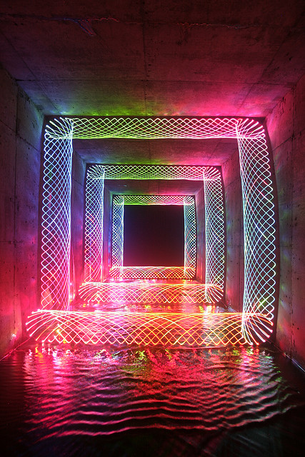
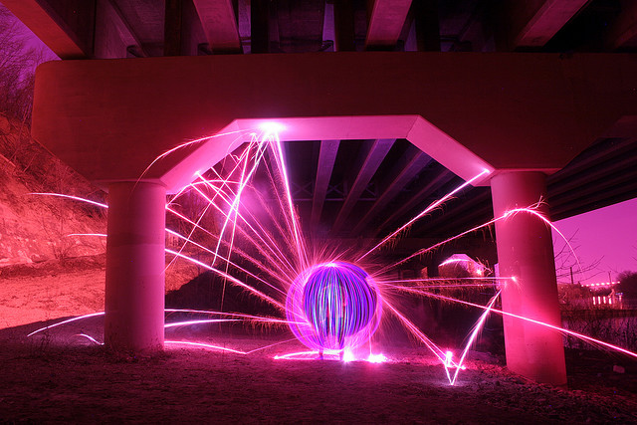
Images of work

Slide 3
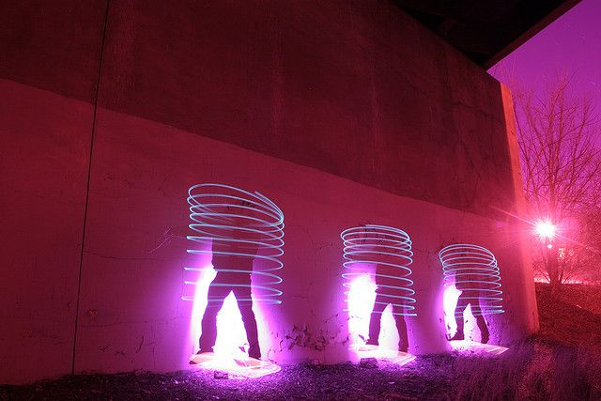
Details about the Photography
Colorful sharp patterns
3D illusions
Teleport SiFi like tunnel

Slide 4
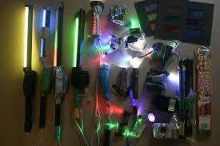
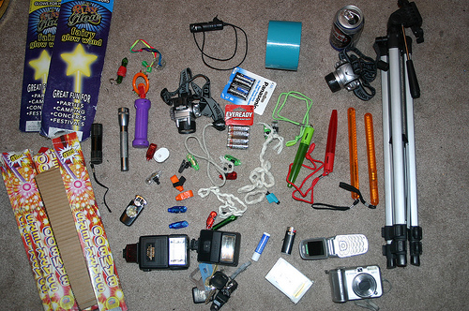
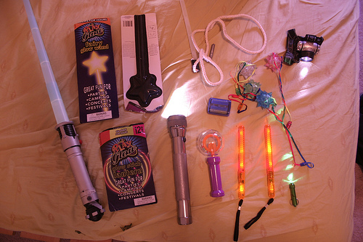
Details about the process
Child toys, flashlights, everyday light
Wave in patterns
Different lights for different sharpness
Chasing LED lights

Slide 5
My thoughts
My thoughts on her work is that it every picture gives me a different perspective and motivates me to want to do better. Her pictures also give me the perspective that its about different dimensions like time travel with such extraordinary patterns.

