Slide 1
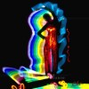
Chanette manso
By: Brianna Salugao

Slide 2
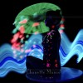
Details about Photography
Manso uses human models.
dancers, indian icons and balancing acts.
Fabrics and light brushes.
uses both film and digital
Tripod

Slide 3
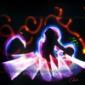
Details On The Process:
She did not give specifics in her process but from what I know, I believe she uses a slow shutter speed and has an IOS 200 and below.

Slide 4
My Thoughts on her work:
Chanette’s work is unique, I love how she uses other peoples talents in the picture. She captures the people dancing and expressing themselves in their passions instead of making them pose and fitting here view. I honestly think she is surprised by the outcome of the pictures.

