Slide 1
Cenci Goepel and Jens Warneckle
By: Erica Ricardo

Slide 2
About Cenci Goepel and Jens Warneckle
They travel around the world doing light paintings
The use natural resources, like the moonlight, and flashlights and torches
Have been published in major international magazines and books
Take light paintings at night using low ISO and shutterspeed.

Slide 3
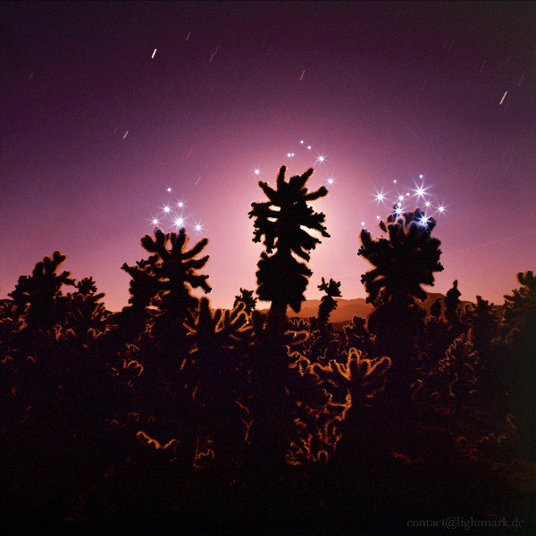
Cholla Cactus Garden, Joshua Tree National Park, California, USA. Lightmark No.50
“The teddy-bear cholla is a cactus native to California, Arizona, and Nevada and northwestern Mexico.”
The cacti look soft and fuzzy due to the lighting that makes them look black with a little bit of the light making some of the cacti somewhat visible. The cactus is named “teddy bear” because from far away, the stems look fuzzy and not prickly.

Slide 4
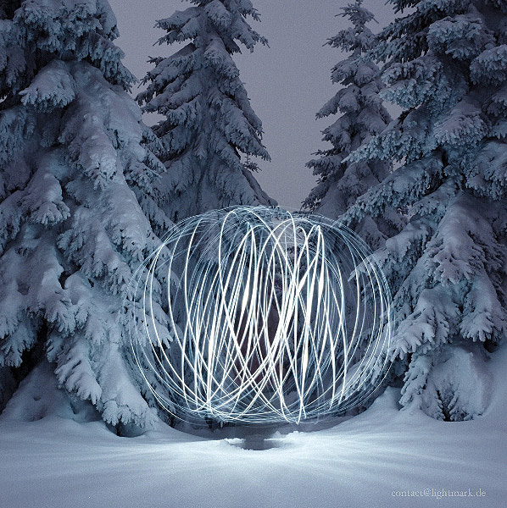
Harz, Germany Lightmark No.24
The Harz is the highest mountain range in northern Germany and its rugged terrain extends across parts of Lower Saxony, Saxony-Anhalt and Thuringia.”
This light painting looks like there is a big ball of wire or like a messed up slinky. It is not that visible but there's a person in the middle of those trees swinging , maybe, a flashlight in a big circle.

Slide 5
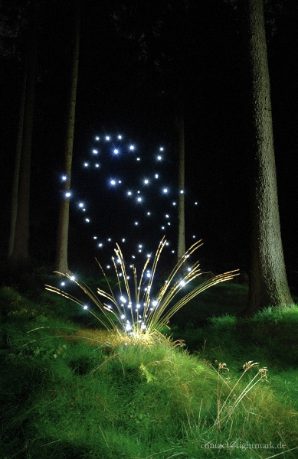
Schwarze Berge, Rosengarten, Germany Lightmark No.15
The “German Forest” is used as a metaphor and has a sense of longing to it. During the 19th century, this place was used as setting of fairytale, folk stories, and more. It looks like they used fireworks to produce this painting. It kind of looks like a flower, dandelion, blossoming and slowly drifting away.

Slide 6
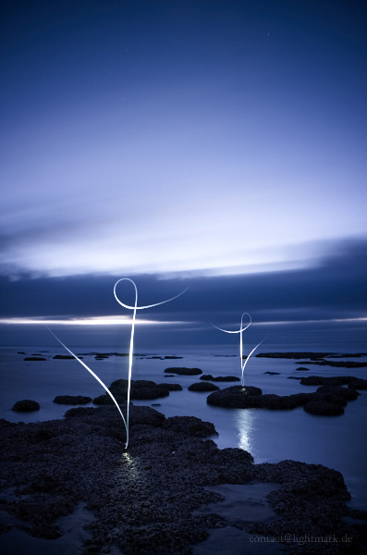
Hamelin Pool Marine Nature Reserve, Western Australia Lightmark No.97
This light painting was taken on rocks that looked similar to stromatolites (they couldn’t shoot on actual stromatolites due to them being so fragile). I believe that they have put flashlights down on the ground. This picture, to me, looks like dancers with their leg in the air trying to do a split. In the back the clouds look to be moving and blurry, so this is sort of panning.

