Slide 1
Cenci Goepel & Jens Warnecke
By: Erica Walker

Slide 2
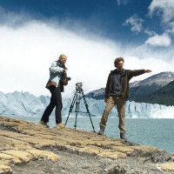
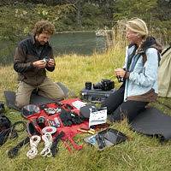
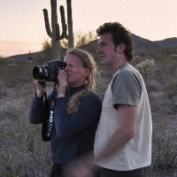
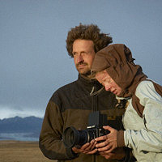
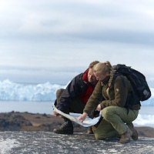
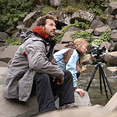
About Their work…
“Lightmark”, is the body of work that these two German artists created. They did so by photographing moving light sources at night. These long exposure photos can take up to an hour! They use torchlight and the moons ambient light as well as eerie landscapes to create such photos. They use a
“Lightmark”, is the body of work that these two German artists created. They did so by photographing moving light sources at night. These long exposure photos can take up to an hour! They use torchlight and the moons ambient light as well as eerie landscapes to create such photos. They use a digital medium format camera, and focus mainly on photographic techniques rather than post processing to have such extraordinary results.

Slide 3
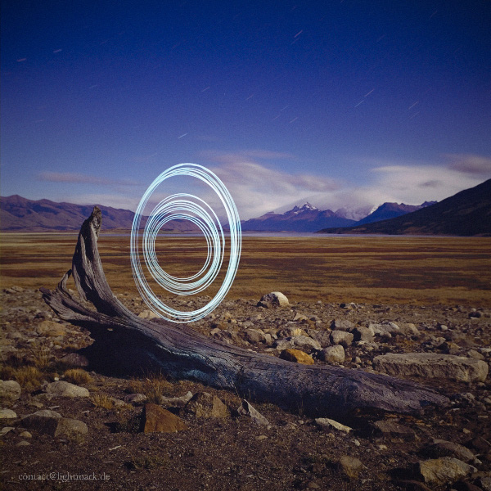
Composition is a deciding factor…
"In this photo, we spun a band with LED flashlight on a single plane only. The spiral shape is a result of the gradual shortening of the band as it spins. In order to achieve the space between the outer and inner rings of the spiral, we paused exposure for a brief period of time.“
For these two, light painting is only one element of the finished photograph, which is why they seek out places that are generally already breathtaking.

Slide 4
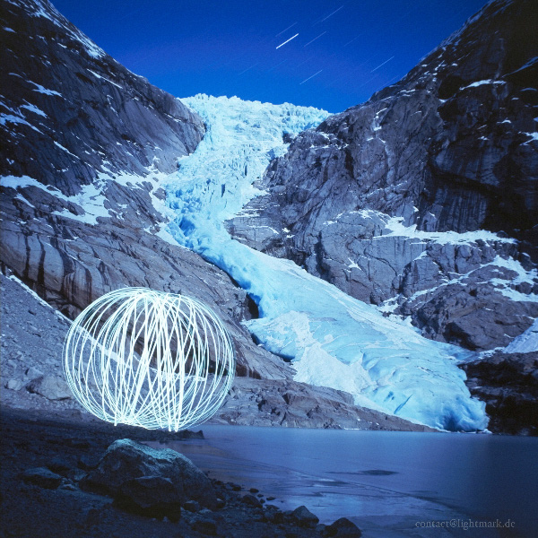
Techniques, Tips, & Tricks
Goepel and Warnecke have experimented with many different light sources, but generally resort to simple ones! They have found that LED lights are geberally the best to work with especially in terms of detail. Finding the right light source can be hard as you cant tell which is best until you take the actual photo.
The design of lenses, reflectors, and LED lights can affect the final product so its good to know what you are working with quite well, and experiment!

Slide 5
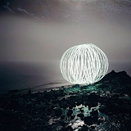
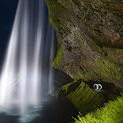
Techniques, Tips, & TRicks
Know your equipment.
Wear black and move fast when in frame – avoid shining light on yourself!
Find good ambient light sources! (It adds to the depth of your photos!)
Consider your overall composition.
Keep your ISO low to avoid noise!

Slide 6
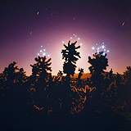
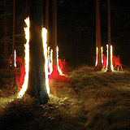
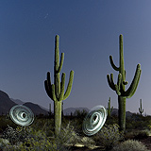
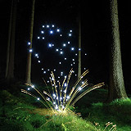
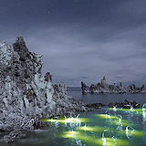
Other pieces of their work…

