Slide 1
Alan Jaras
Brianna Wilson

Slide 2
He calls his images “refractographs”, shooting photos of light sources through a selection of multicolored glass, plastics and other transparent or translucent objects.

Slide 3
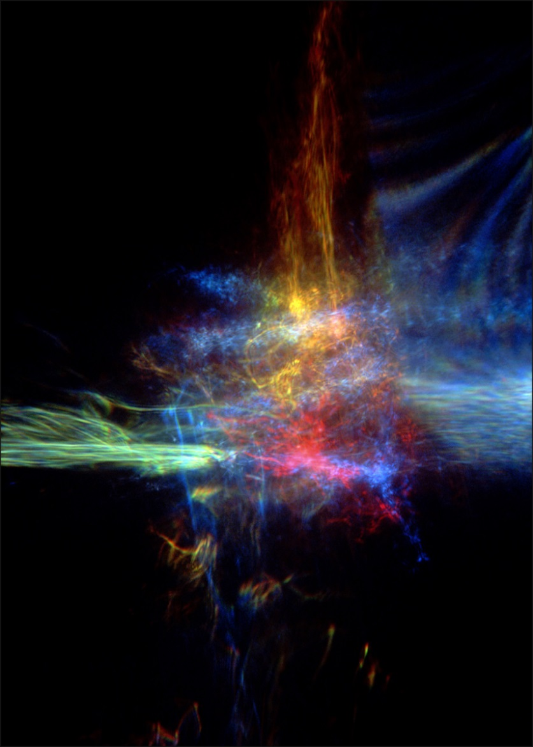
Jaras breaks down his seemingly unclassifiable images into at least three genres, “Bending”, “Twisting”, and “Taming” light.

Slide 4
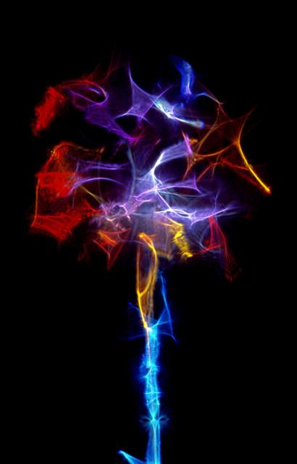
Jaras has interesting and cool photos using light painting. I think he does amazing work that has artistic framework and great skill.

Slide 5
